Slide 1

Pathfinder Bible Experience
2017
Paul’s Writings

Slide 2
Paul’s Writings
Galatians
Ephesians
Philippians
Colossians
1 & 2 Timothy
http://www.uccsda.org/Pathfinders/bibleachieve

Slide 3
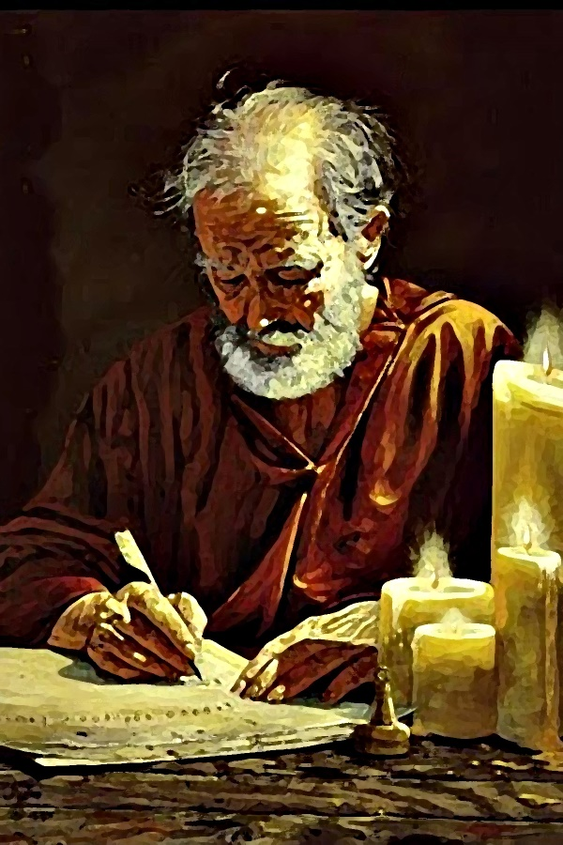
Colossians
Paul’s letter to the

Slide 4

Chapter 1

Slide 5

According to Colossians 1:5-6, What was the gospel producing?
1 point
25
Answer: (It was bringing forth) fruit

Slide 6
According to Colossians 1:7, who was a faithful minister in Colossae?
1 point
25
Answer: Epaphras

Slide 7



What phrase in Colossians 1:9-13 might come to mind with the following picture?
1 point
25
His will
Answer: filled with the knowledge of His will in all wisdom and spiritual understanding

Slide 8
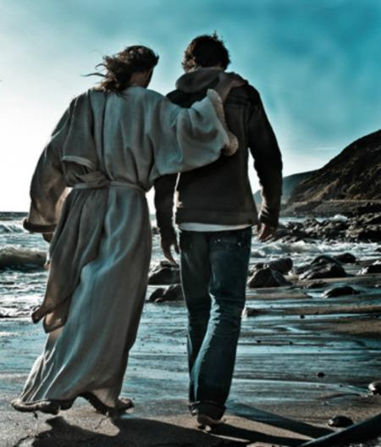
What phrase in Colossians 1:9-13 might come to mind with the following picture?
1 point
25
Answer: walk worthy of the Lord

Slide 9

What phrase in Colossians 1:9-13 might come to mind with the following picture?
1 point
25
Answer: fruitful in every good work

Slide 10

What phrase in Colossians 1:9-13 might come to mind with the following picture?
2 points
25
Answer: increasing in the knowledge of God

Slide 11
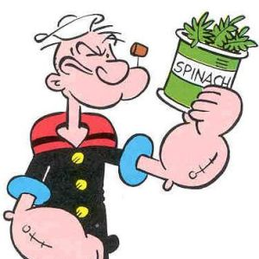
What phrase in Colossians 1:9-13 might come to mind with the following picture?
1 point
25
Answer: strengthened with all might

Slide 12
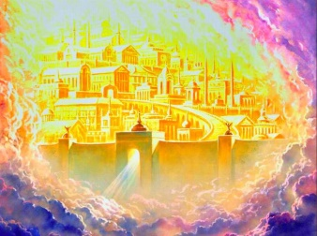

What phrase in Colossians 1:9-13 might come to mind with the following picture?
1 point
25
Answer: qualified us to be partakers of the inheritance of the saints in the light

Slide 13
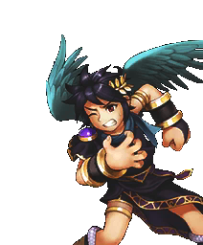
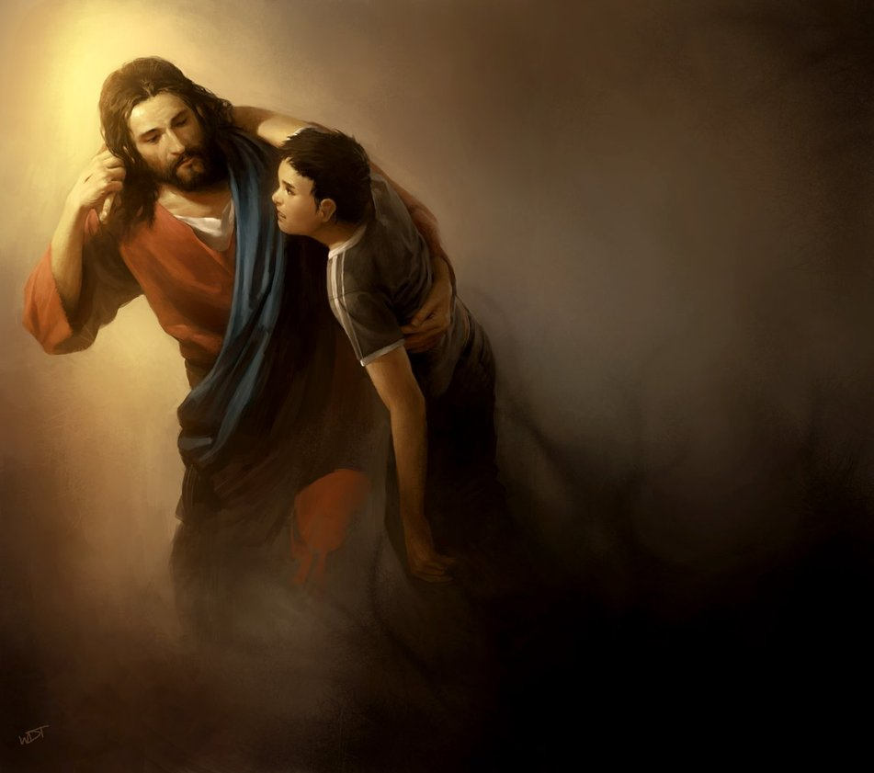
What phrase in Colossians 1:9-13 might come to mind with the following picture?
1 point
25
Answer: delivered from the power of darkness

Slide 14
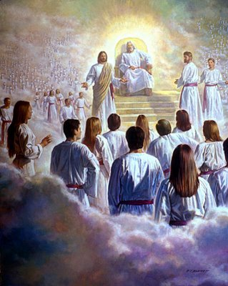
What phrase in Colossians 1:9-13 might come to mind with the following picture?
1 point
25
Answer: conveyed us into the kingdom of the Son of His love

Slide 15
Say Colossians 1:9 from memory.
10 points
25
Answer: “For this reason we also, since the day we heard it, do not cease to pray for you, and to ask that you may be filled with the knowledge of His will in all wisdom and spiritual understanding.”

Slide 16
Say Colossians 1:10 from memory.
10 points
25
Answer: “that you may walk worthy of the Lord, fully pleasing Him, being fruitful in every good work and increasing in the knowledge of God.”

Slide 17
1 point
25
According to Colossians 1:16-18,
which are descriptions of Jesus?
He’s the image of the invisible God
He’s firstborn of creation
All things were created through Him and for Him
He is before all things
He is the head of the body, the church
He is the firstborn from the dead
a & e
All the above

Slide 18
According Colossians 1:16-18, Jesus is first born or holds the place of honor in many different areas. Name 4 things He is ‘first’ in.
4 points
25
Answer:
He’s firstborn of creation -- All things were created through Him and for Him
He is before all things
He is the head of the body, the church
He is the firstborn from the dead (to live eternally)

Slide 19
Say Colossians 1:16 from memory.
10 points
25
Answer: “For by Him all things were created that are in heaven and that are on earth, visible and invisible, whether thrones or dominions or principalities or powers. All things were created through Him and for Him.”

Slide 20
1 point
25
What does “reconcile” mean?
to restore friendly relations
to make it compatible or show that it is compatible
to get mad at them
to sing in a concert
a & b
none of the above

Slide 21
According Colossians 1:19-20, God wanted to reconcile (or restore friendly relations) with us and all things in heaven and earth. True or False?
1 point
25
Answer: True

Slide 22
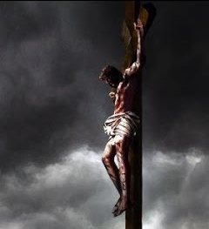
According to Colossians 1:20, how did God reconcile us or make peace with us?
2 points
25
Answer: through the blood of His (Jesus’) cross

Slide 23
Complete Colossians 1:21-23, ”And you, who once were alienated and enemies in your mind by wicked works, yet now He has __________ in the body of His flesh through death, to present you holy, and ________, and above reproach in His sight— if indeed you continue in the ____, grounded and steadfast”?
3 points
25
Answer: reconciled, blameless, faith

Slide 24
Chapter 2

Slide 25
1 point
25
According to Colossians 2:2-3,
where is the treasures of wisdom and knowledge hidden?
at school
in the library
in the Father and Christ
in Paul
in the leaders of Colossae
in our brains

Slide 26


Complete Colossians 2:6, “As you therefore have received Christ Jesus the Lord, so walk in Him, ______ and _____ up in Him and established in the faith, as you have been taught, abounding in it with _____________.”
3 points
25
Answer: rooted, built, thanksgiving

Slide 27
Complete Colossians 2:9, “For in Him (Christ) dwells all the fullness of the __________ bodily; and you are complete in Him, who is the head of all principality and _______.”
2 points
25
Answer: Godhead, power

Slide 28
1 point
25
According to Colossians 2:11-13,
How have we been circumcised?
in the flesh by human hands
in the heart
without hands
by being buried with Christ in baptism
c & d
b & d

Slide 29
According to Colossians 2:16, should we judge others by what they eat, drink, or in regard to religious holidays?
1 point
25
Answer: no
(These are not ‘salvation issues’)

Slide 30
Chapter 3

Slide 31
1 point
25
According to Colossians 3:1-2,
what should we seek or set our mind on?
things hidden
Waldo
things above
things on earth
Nemo

Slide 32
1 point
25
According to Colossians 3:5,
what should we put to death?
spiders and snakes
fornication & uncleanness
evolution
evil desire & covetousness
bad guys
b & d
A&W

Slide 33
Complete Colossians 3:8-9, “But now you yourselves are to put off all these: anger, _____, malice, blasphemy, filthy __________ out of your mouth. Do not ___ to one another, since you have put off the old man with his deeds,”
3 points
25
Answer: wrath, language, lie

Slide 34
Complete Colossians 3:12-13, “Therefore, as the elect of God, holy and beloved, put on tender mercies, _______, humility, meekness, ___________; bearing with one another, and _________ one another,…”
3 points
25
Answer: kindness, longsuffering, forgiving

Slide 35
Complete Colossians 3:14-15, “But above all these things put on ____, which is the bond of perfection. And let the ______ of God rule in your hearts, to which also you were called in one body; and be _________. ”
3 points
25
Answer: love, peace, thankful

Slide 36
1 point
25
According to Colossians 3:16,
how should we admonish each other?
with songs and a heart full of grace
with a group of friends
never
in anger
with Paul’s letters

Slide 37
Complete Colossians 3:17, “And whatever you do in word or deed, do all in the _____ of the Lord _____, giving _______ to God the Father through Him.”
3 points
25
Answer: name, Jesus, thanks

Slide 38
1 point
25
According to Colossians 3:18,
in a Christian home, how should wives treat their husbands?
with cookies and other sweetness
submit and show respect
with body rubs and love
leave them alone
in anger

Slide 39
1 point
25
According to Colossians 3:19,
in a Christian home, how should husbands treat their wives?
give them flowers, jewelry & chocolate
love them and never be bitter
leave them alone
let them shop till they drop

Slide 40
1 point
25
According to Colossians 3:20,
in a Christian home, how should children treat their parents?
draw pictures and bring flowers
throw hugs and kisses
obey them
demand the best and most popular things
run away

Slide 41
1 point
25
According to Colossians 3:21,
in a Christian home, how should fathers treat their children?
provoke them
discourage them
give them a hug, kiss, & a kick in the pants
do not provoke them
do not provide for them

Slide 42
Complete Colossians 3:23, “And whatever you ___, do it heartily, as to the _____ and not to men,”
2 points
25
Answer: do, Lord

Slide 43
Chapter 4

Slide 44
Complete Colossians 4:1, “Masters, give your bondservants what is just and ____, knowing that you also have a Master in __________.”
2 points
25
Answer: fair, heaven

Slide 45
1 point
25
According to Colossians 4:6,
how should we speak to others, especially to non-Christians?
with grace, seasoned with salt
with sarcasm, sprinkled with sugar
with falsehoods, smothered in peanut butter
with political correctness, with a cherry on top
with love, dipped in chili powder

Slide 46
According to Colossians 5:7-9, who will tell the Colossian church all the news about Paul and those with him?
2 points
25
Answer: Tychicus & Onesimus

Slide 47
1 point each
25
According to Colossians 5:7-17,
who was working with Paul at this time? Choose all applicable.
Tychicus
Onesimus
Aristarchus
Mark
Barnabas
Jesus, called Justus
Epaphras
Luke
Demas
Answer: all the above (a,b,c,d,e,f,g,h,& i)

Slide 48
According to Colossians 5:16, with which church were the Colossians supposed to share their letter with and also read their letter?
1 point
25
Answer: Laodicea

Slide 49
According to Colossians 5:17, finish Paul’s message to Archippus: “Take heed to the ministry which you have received in the Lord, that you may _____ ___.”
1 point
25
Answer: fullfill it

Slide 50
According to Colossians 5:18, who wrote the book of Colossians?
1 point
25
Answer: Paul (in his own hand)

