Slide 1

Christian Manners & Grooming
Pathfinder Honor
for Explorers

Slide 2

Inner Beauty and Strength
Becoming who God intended you to be

Slide 3
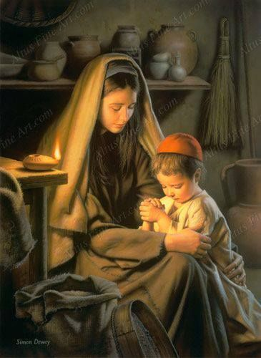
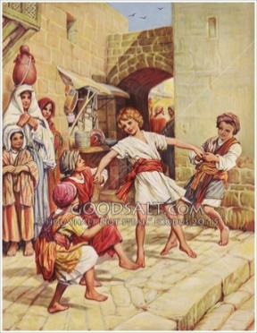
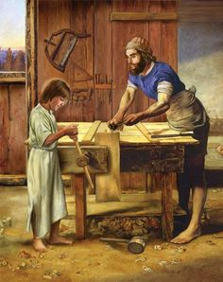
JESUS
Luke 2:52
Jesus grew in wisdom
What well balanced combination of strengths did Jesus develop as a growing youth?
and STATURE
and in favor with God
and man

Slide 4








MY WORTH ACCORDING
TO THE LORD
Who or what is the crowning act of creation?
Crowned with what?
Read Psalms 8
glory and honor

Slide 5

Are names important to God?
Does He know your name?
Read:
Isaiah 34:1
Exodus 33:17
Isaiah 45:4

Slide 6
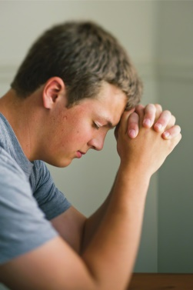

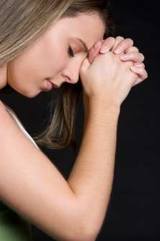

How can I keep my soul “clean”?
Read the Bible
Pray everyday
Confess sin
Believe Jesus forgives your sin
Remember you are a child of God
Trust and obey

Slide 7



Keep your thought life clean
Read
Philippians 4:8

Slide 8


Slide 9
Keep your thoughts positive
Read
Philippians 4:8

Slide 10


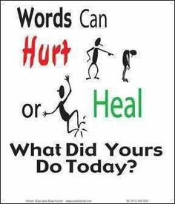
Read Psalms 19:14
If you want to use your gift of speech to God's glory, what should your prayer be?

Slide 11
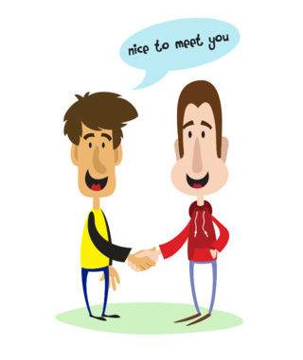
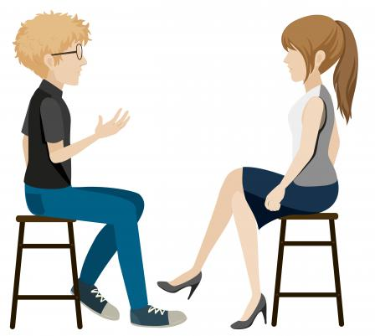
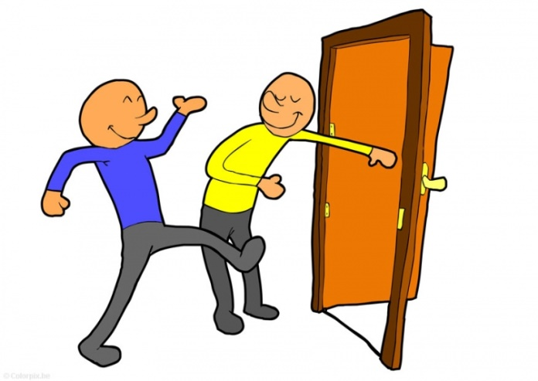
PROPER Behavior
Being Ladies and Gentlemen

Slide 12

What are some proper conversational skills?
Address older people using a proper title -- such as:
Mr.
Mrs.
Miss
Ms.
Aunt
Uncle
Doctor
Pastor
etc.
Introduce adults using their proper title and how you know them.
Introduce a woman before a man
Introduce an older person before a younger person
Tell each person something about the other person that will interest them.

Slide 13
Introduce yourself to a friend
Stand
Smile
Say
Shake
Say

Slide 14
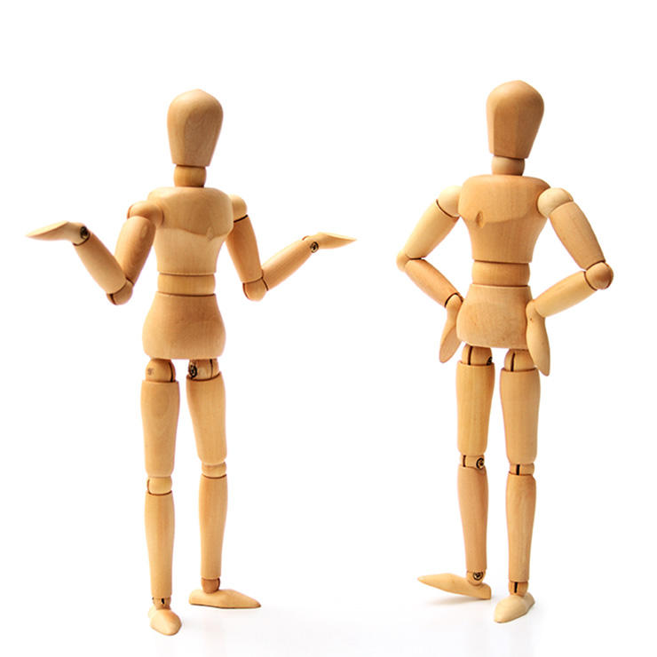
Body language and
Good Manners

Slide 15

What should I say?
AVOID
Don’t comment on physical defects
Don’t ask personal questions
SUCH AS
"When last did you have a shower?"
"Don't you think you should try to lose a little weight?"
"How much money do you make?"
"How old are you?" -- Speaking to someone your senior
DO TALK ABOUT
pleasant things
things that interest both of you
family & friends
special events
ASK QUESTIONS
about their family
about their work, school, or special events
about their favorite things

Slide 16

Small Talk and Conversations
Hey, what are you up to today
So, what do you like to do for fun, when you’re not working
How do you know (the host)
Are you having a good week? What is the highlight?
What is your story?

Slide 17


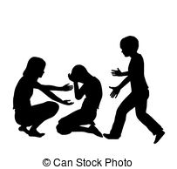
How do you show concern for others?

Slide 18
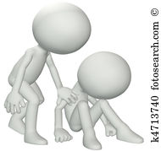
How do you show concern for others?
Show interest, be empathetic, and don’t change the subject before they are ready to.
Which is better is a better response if someone tells you about something bad that happened such as:
Alice: "My sister was in a car accident yesterday."
Option 1
Bob: "That's too bad. Did I tell you I beat level 14 in 'Mega Chipmunk Death Rally' this morning?“
Option 2
Bob: "Your sister was in an accident? Is she OK?
… What happened? … Where is she now?"

Slide 19
Try it – Be empathetic
Bill broke his arm. How can you help him?
Hazel is on her hands and knees looking for something. Her bike is beside her. She says she lost her contact and can’t see.
Sally walked through the door with a pile of books. You accidently bumped her, sending the books flying.
For more scenarios go to: http://www.uua.org/re/tapestry/children/tales/session4/123257.shtml

Slide 20
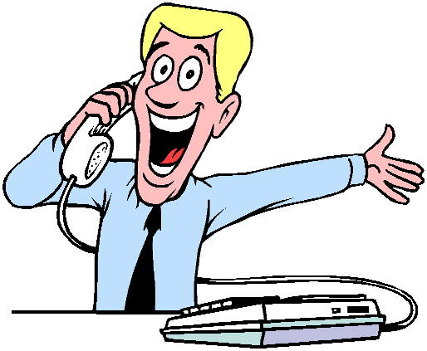
How should I answer the phone?
When answering the phone at home, nothing beats this old classic: "Hello?" It is also good to say after this greeting the period of day, such as “Good morning!” or “Good evening”
When answering for a business, the rules change. In this case, you are expected to answer with the name of the company, as in "Spacely Sprockets, how may I help you?"

Slide 21

Maintain sexual purity
Read the following verses
Exodus 20:14
1 Corinthians 6:9-10
Matthew 5:27-28

Slide 22
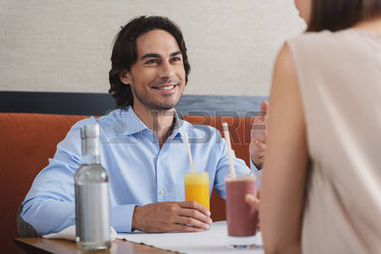
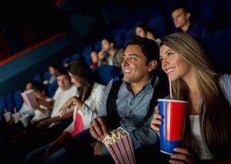
A perfect date
It’s with someone you want to get to know better
You are super respectful to them & their parents
  You meet & greet their parents
  Men escort the lady, open the door for the lady, seat the lady, help the lady with her coat, care for the lady! Ladies, you show appreciation for the man’s respectful care for you
  You stay within the boundaries expected
  You get back on time
You both have fun – simple, pure fun with no regrets; You talk and get to know eachother

Slide 23
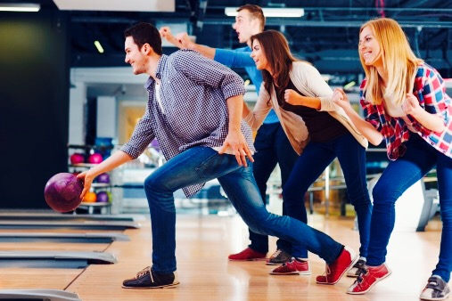
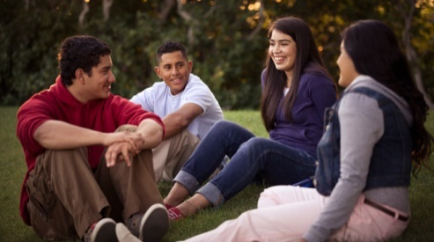
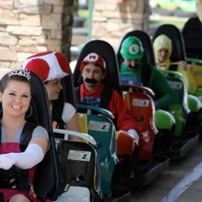

A perfect date….

Slide 24
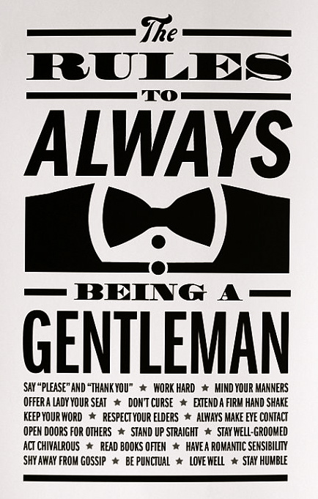
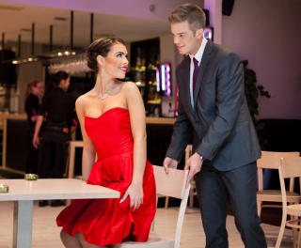
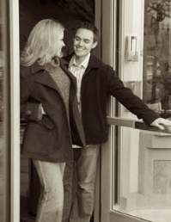
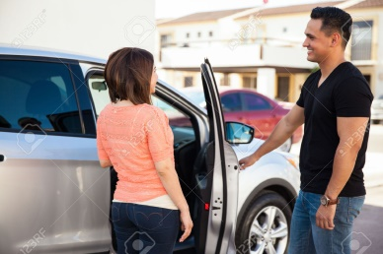
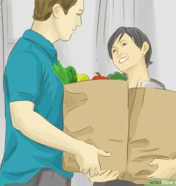
Chivalry is alive: Be a Gentleman

Slide 25

Ladylike charm with grace & elegance

Slide 26
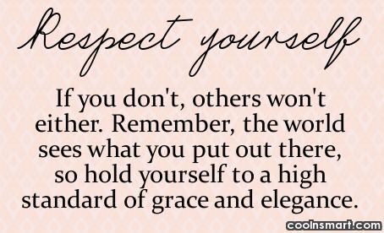
Be a lady with GRACE and elegance
Gracefully walk and talk
Respect yourself & others
Always smile
Confidence
Elegantly act and dress

Slide 27
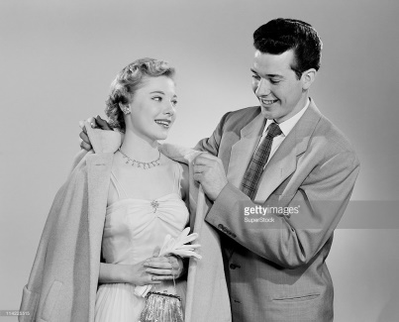
Gentlemen assist a lady with a coat
This is an art for both the guy and the girl. Practice makes perfect.

Slide 28
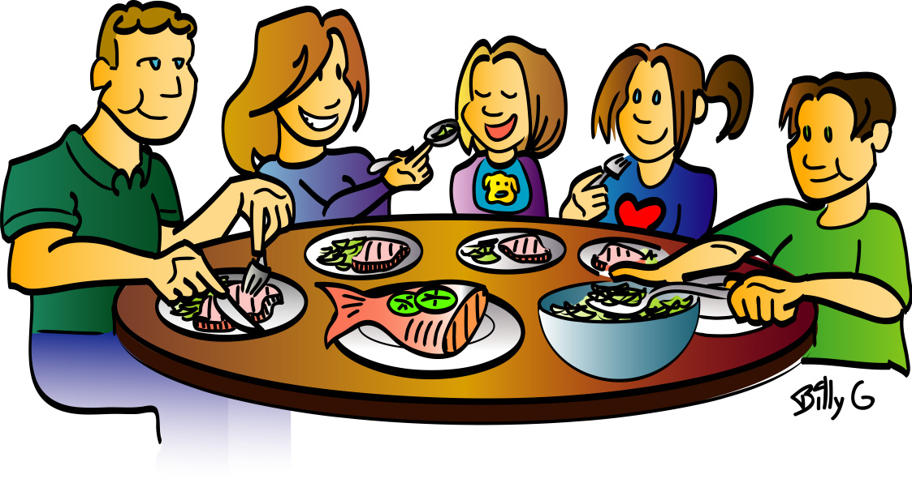
What has your family taught you about meat time etiquette?

Slide 29
Proper mealtime behavior
Chew with your mouth closed.
Do not talk at an excessively loud volume.
Refrain from coughing, sneezing or blowing nose at the table.
Never tilt back your chair while at the table, or at any other time.
Do not make unbecoming noises while eating.
Do not play with food or table utensils.
Do not single out or chastise someone who has shown poor table manners.
Do not put your elbows on the table or slouch. It is acceptable, however, to rest for-arms, up to the elbow, on the table.
Always ask the host or hostess to be excused before leaving the table.
Do not stare at anyone while he or she is eating.
Never talk on your phone at the table. If urgent, ask host or hostess to be excused, and go outside. Apologize after returning.

Slide 30
Proper mealtime behavior
A prayer or 'blessing' may be customary in some families, and the guests should join in even if they are not religious or do not follow the same religion. Most prayers are made by the host before the meal is eaten. Instead or in addition, a 'toast' may be offered.
Do not start eating until (a) every person is served or (b) those who have not been served request that you begin without waiting. At more formal occasions all diners will wait to begin until the hostess or host lifts a fork or spoon.
When a dish is presented 'family style', the food is served to one's plate and then passed on to the next person. put the food on your left, take some and pass to the person next to you.
When serving, serve from the left and pick up the dish from the right. Beverages are both served and removed from the right.
Eat soup noiselessly and with the side of the spoon.
Hot drinks should never be poured into the saucer to cool but should be sipped from the cup. Alternatively, ice may be used to cool them.
Seasoning ones meal prior to tasting can be considered rude and may insult the chef.

Slide 31
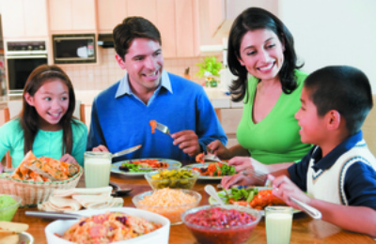
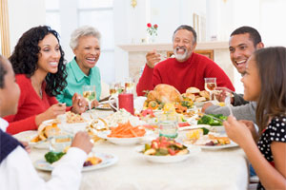
Proper mealtime behavior
It is acceptable in most places to not finish all of the food on your plate.
When finished with your meal, place your knife and fork with handles at the 4 o'clock position and the tines of the fork down to signal to the server you are done.
Except in a public restaurant, do not ask to take some of your uneaten food away from the meal after it ends, and never when attending a formal dinner.

Slide 32
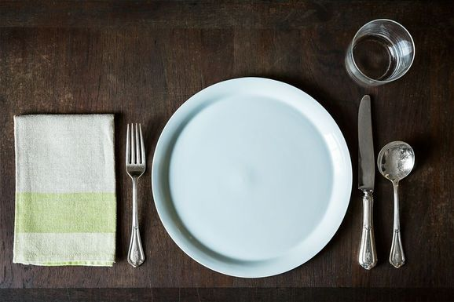
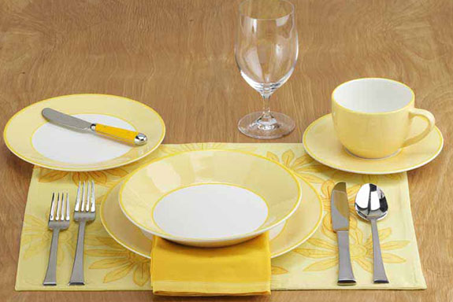
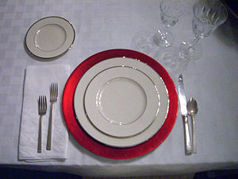
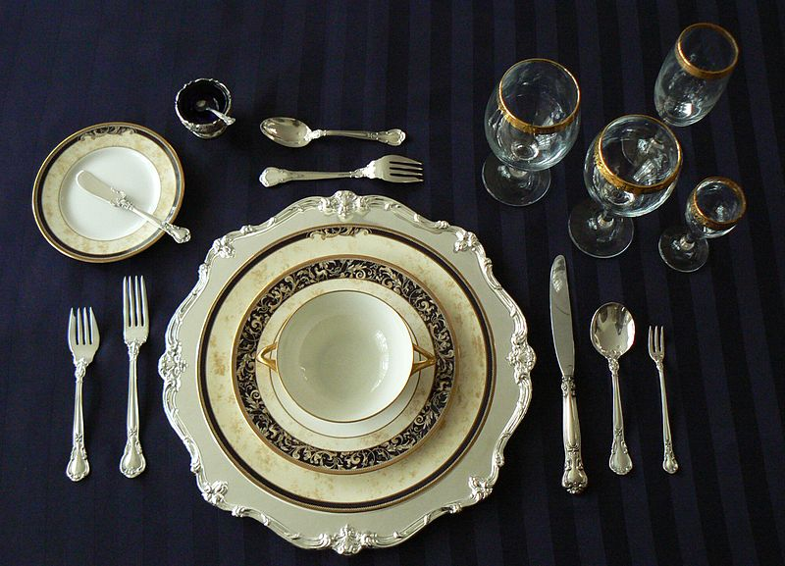
Properly set a table
DO it

Slide 33



Formal Dining Etiquette

Slide 34
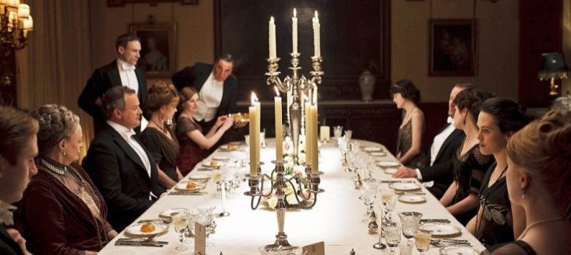
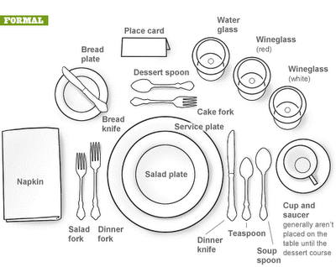
Formal Table setting
Start on the outer edge and move towards the dinner plate

Slide 35
Meal Time Etiquette Quiz
What do you know about meal etiquette?
How should I proceed with a table serving like this:

Slide 36
Proper meal time behavior
What does your mom say? What have you heard?
What did they do wrong? -- right?

Slide 37

Health and Wellness
Looking good … Feeling great!

Slide 38

How can you overcome self-consciousness and social embarrassment
Christ died for you
Make sure your hair is clean and combed.
Make sure your face and body are clean
Wear deodorant/antiperspirant.
Brush your teeth and have a breath mint or sugar-free gum
You are not the only self-conscious person
People are unlikely to be focusing on you
Admit your mistakes
Admit your embarrassment
A little humor goes a long way

Slide 39
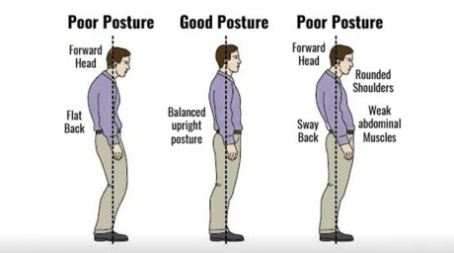
Describe the benefits of good posture.
"Among the first things to be aimed at should be a correct position, both in sitting and in standing. God made man upright, and He desires him to possess not only the physical but the mental and moral benefit, the grace and dignity and self-possession, the courage and self-reliance, which an erect bearing so greatly tends to promote. Let the teacher give instruction on this point by example and by precept. Show what a correct position is, and insist that it shall be maintained."
-- Education, page 198, paragraph 3

Slide 40
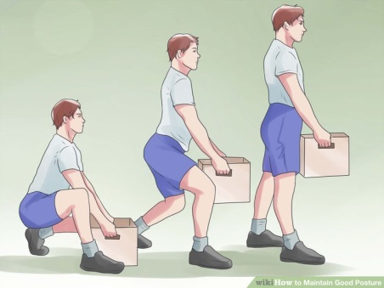
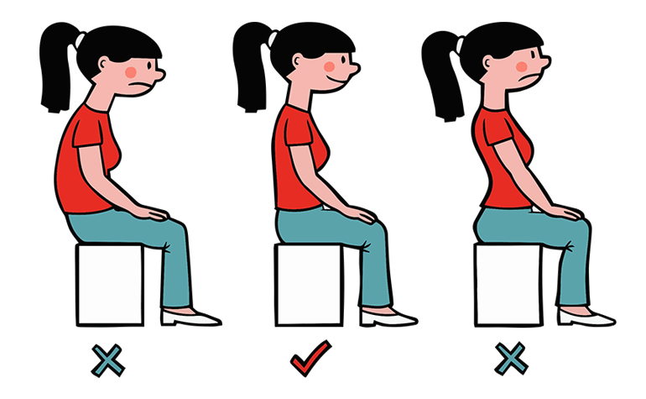
Describe good posture.

Slide 41
Exercise to improve your posture

Slide 42
Describe the benefits of good posture.
Good posture does the following:
Provides optimal balance.
Optimizes breathing.
Affects the circulation of bodily fluids.
Reduces back pain.
Protects the joints from strain.
Expresses confidence.
Is considered an integral part of physical attractiveness.
Improves the body's ability to carry heavy loads.
Protects against spinal deformity as a person ages.

Slide 43
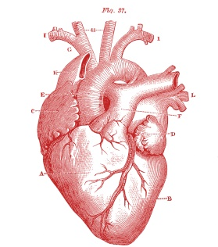
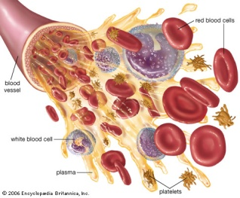
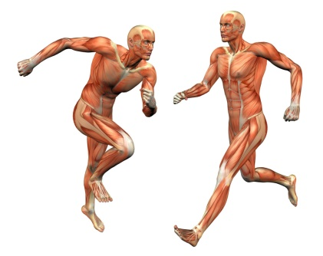
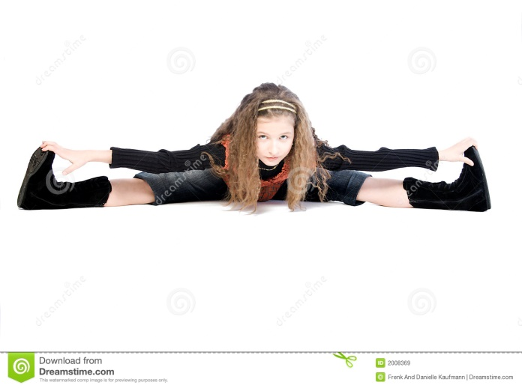
Why is physical fitness important?

Slide 44
Time to get moving!

Slide 45
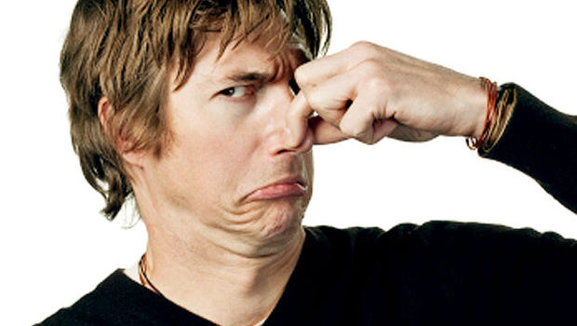
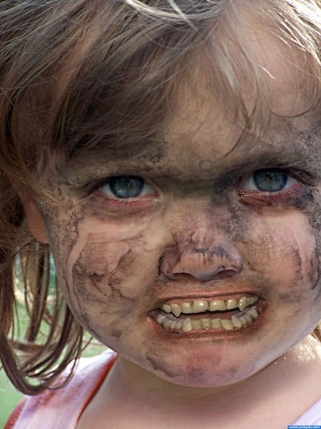
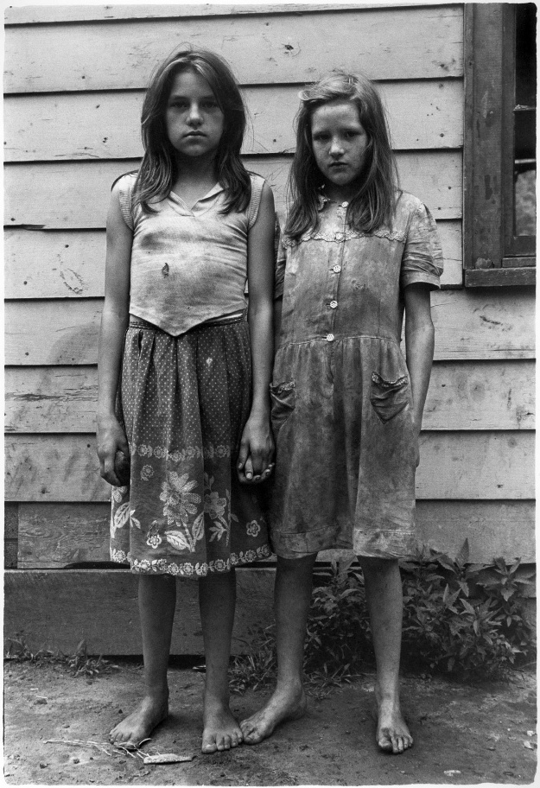
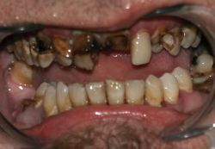
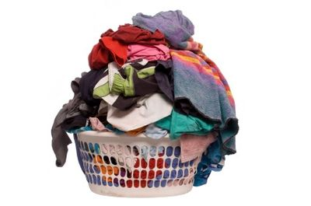
What is the importance of proper grooming? Why should we do the following:
bathe or shower regularly
brush teeth
wash our clothes
clean our shoes

Slide 46
Cleanliness is next to godliness
germs
bathe everyday
optional 12 min.

Slide 47
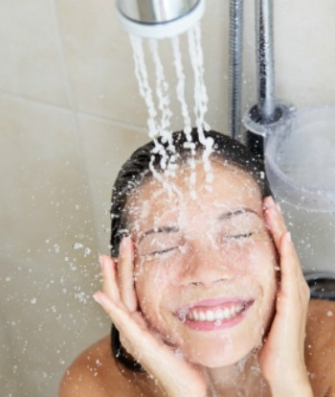
How to wash hair

Slide 48
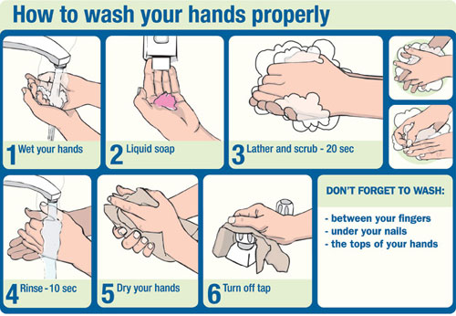
How to wash hands

Slide 49
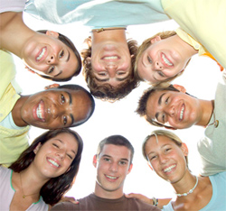
Why is your face important?
It is the first thing that others see.
It is one of the main communicators of your emotions.
Most people define "pretty" or "handsome" based on the way a person's face appears.
People recognize you more by your face than by any other part of your body. Your face defines you.

Slide 50
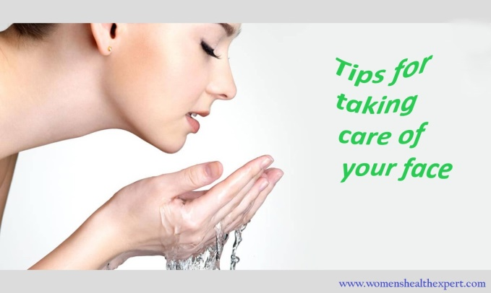
Care for your face

Slide 51


Sleep affects your face & appearance

Slide 52

Facial Expressions
Do it … make a facial expression … others guess what it means

Slide 53

Dress Your Best
Finding your style

Slide 54

Dressing for your Body Type
Skinny? Add bulk with pockets, horizontal stripes, patterns, and thicker fabric
Short? Add height with well fitted pants and V necks. Wear shorter jackets.
Stocky? Less bulk with straight pants, mid fit raise, sleek shirts & shoes

Slide 55
Choosing jeans for your body type

Slide 56

5 dresses for
5 body types
Accentuate the smaller body parts, drawing attention away from ‘bulky’ areas

Slide 57

See more at:
http://visual.ly/guide-womens-clothing-based-body-type

Slide 58
Choose fashions for a body
BOYS
Choose fashions from a clothing advertisement that would look good on your body type. Remember the pointers learned.
OR
Go online to the following site and dress the guy:
http://hair-boys.goldhairgames.com/hair-games-for-boys/153-hair-games-and-dress-up-for-boys
GIRLS
Choose fashions from a clothing advertisement that would look good on your body type. Remember the pointers learned.
OR
Go online to the following site and dress the girl:
http://hairstyles.goldhairgames.com/hairstyles/148-cold-fashion-and-hair-styles

Slide 59
Choose a hairstyle that fits you
When identifying the best hairstyle for you it’s crucial you first identify:
1) Your face shape, and 2) Your hair texture.
Website resources:
http://www.thehairstyler.com/features/articles/hairstyles/the-right-hairstyle-for-your-face-shape

Slide 60

Another look …. choosing hairstyle

Slide 61
For men – how to choose a hairstyle

