Slide 1
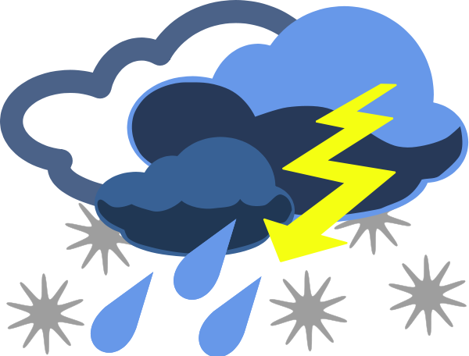
Advanced Weather Honor
Optional for
Explorer Pathfinders

Slide 2

Cyclonic and Anticyclonic weather
Cyclones follow predictable paths and bring rain.
How much rain depends on the strength of the storm. Video – 6:30 min.

Slide 3
Cold Fronts and Warm Fronts
Cold front: leading edge of a cooler and drier mass of air; are faster; rain
Warm front: leading edge of a mass of warm air; moves slower; rains longer

Slide 4
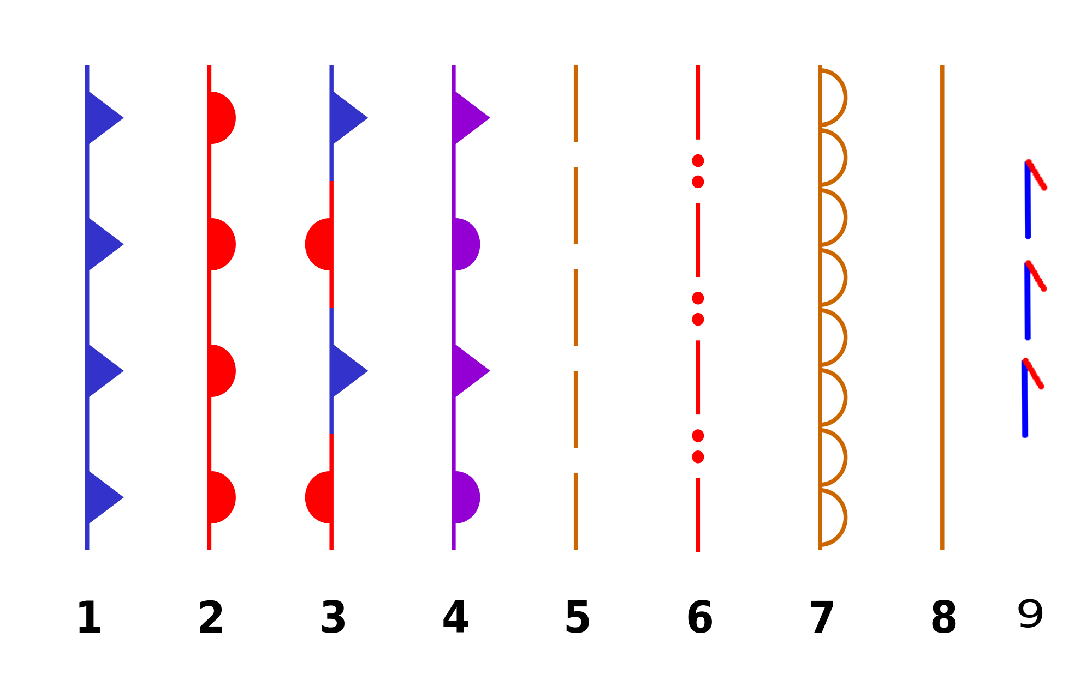
Weather Symbols
cold front
warm front
stationary front
occluded front
surface trough
squalls/ shear line
dry line
tropical wave
trowal

Slide 5
Reading Weather Symbols

Slide 6
Relative humidity vs. dew point
The amount of water that air can hold depends on the temperature. The hotter it gets, the more water the air can hold.
The dew point is the temperature for which the relative humidity will be 100% assuming the amount of water in the air remains unchanged.

Slide 7
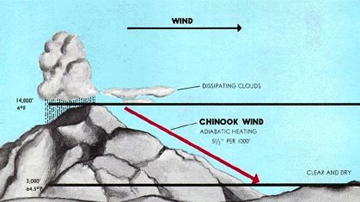
Chinook Winds
Chinook wind SW of mountains in Pacific NW:
warm, very wet, southwesterly wind, likely to bring rain or snow
Chinook winds NE of mountains in Pacific NW
warm and dry; stripped of moisture in mountains

Slide 8
Trade Winds
Trade Winds: pattern of wind that are found in bands around the Earth's equatorial region; prevailing winds in the tropics; blow from high pressured area to low-pressure area around the equater

Slide 9
Belt of Calms = ITCZ
ITCZ = Intertropical Convergence Zone = Intertropical Front, Monsoon trough, Doldrums, or Equatorial Convergence Zone = a belt of low pressure girdling Earth at the equator – is formed by the vertical ascent of warm, moist air from the latitudes above and below the equator.

Slide 10
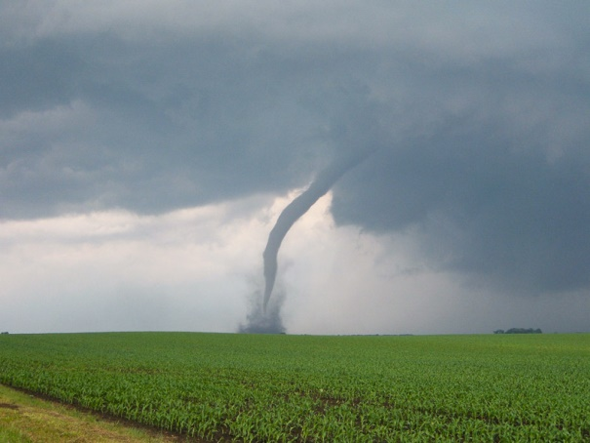
Tornadoes
A tornado is a violently rotating column of air which is in contact with both a cumulonimbus cloud or, in rare cases, a cumulus cloud base and the surface of the earth.

Slide 11
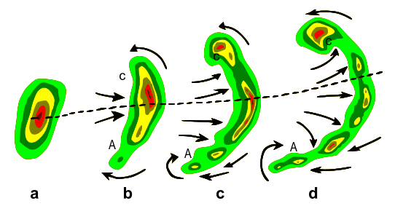
Squall Line
A squall line is a line of severe thunderstorms that can form along or ahead of a cold front.
The best indication of the presence of severe weather along a squall line is its morphing into a line echo wave pattern, or LEWP. A LEWP is a special configuration in a line of convective storms that indicates the presence of a low pressure area and the possibility of damaging winds, large hail, and tornadoes. At each kink along the LEWP is a mesoscale low pressure area. In response to very strong outflow southwest of the mesoscale low, an equatorward portion of the line bulges outward forming a bow echo. Behind this bulge lies the mesoscale high pressure area.
Typical evolution of thunderstorms (a) into a bow echo (b, c) and into a comma echo (d). Dashed line indicates axis of greatest potential for downbursts. Arrows indicate wind flow relative to the storm. Area C is most prone to supporting tornado development.

Slide 12
Squall line
The front line of a storm

Slide 13
Typhoon
A typhoon is a tropical cyclone that originates in the Western Pacific Ocean, and having winds in excess of 118 km/h.
It characterized by a low pressure system center and thunderstorms that produces strong wind and flooding rain. A tropical cyclone feeds on the heat released when moist air rises and the water vapor it contains condenses. Often produce high winds and waves and heavy rain.

Slide 14
Hurricane
A hurricane is a tropical cyclone originating in the Atlantic Ocean and having winds in excess of
118km/h.

Slide 15
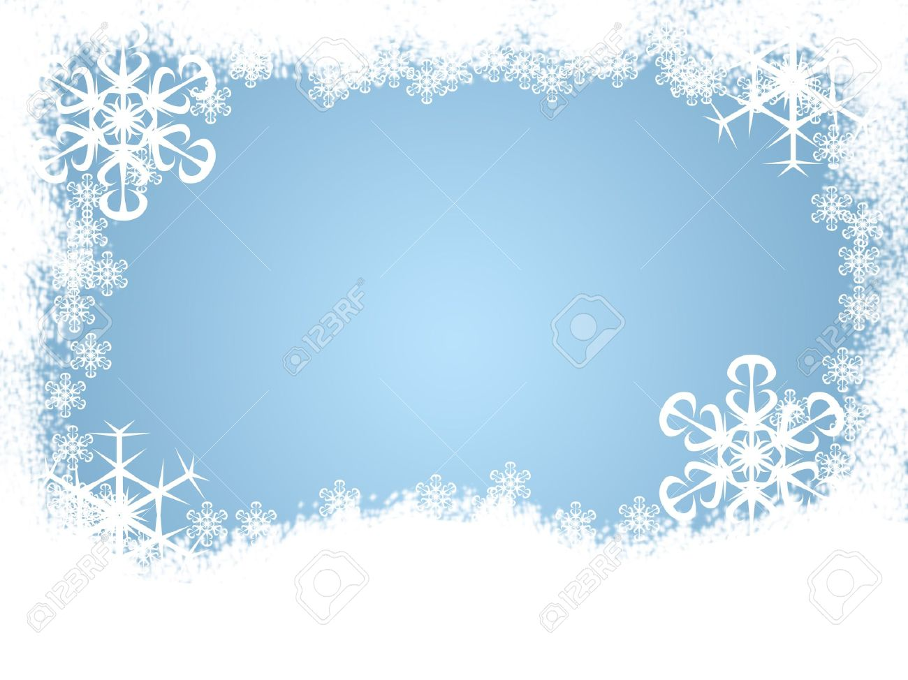
Blizzard
Blizzards: winter storms with frequent winds of 35 mph or higher with falling or blowing snow that reduces visibility to ¼ mile or less for 3+ hours.

Slide 16
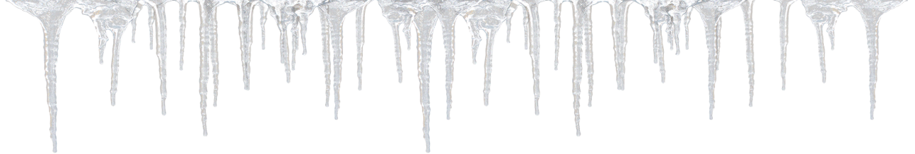
Ice storm
An ice storm is a type of winter storm characterized by freezing rain.
Ice on roads is dangerous! Heavy ice can break roofs, trees, electric wires, etc.

Slide 17
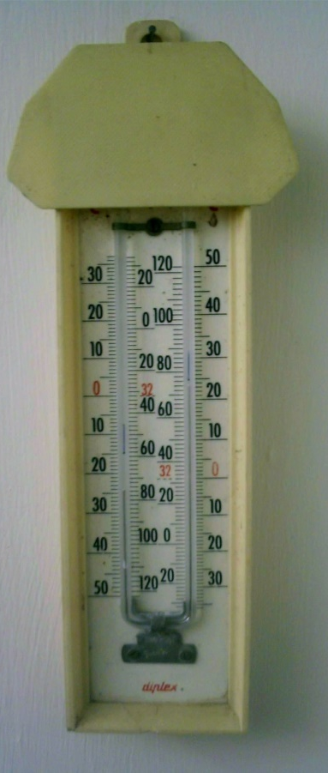
Registering thermometer
A registering thermometer is a thermometer which can measure the maximum and minimum temperature during a given time. It is also known as a Maximum minimum thermometer. It is still in common use wherever a simple way is needed to measure the extremes of temperature at a location.

Slide 18
registering barograph
A barograph is a recording aneroid barometer, which measures barometric pressure. It produces a paper or foil chart called a barogram that records the barometric pressure over time.

Slide 19
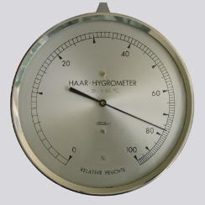
Hygrometer
Hygrometers are instruments used for measuring humidity. A simple form of a hygrometer is specifically known as a "psychrometer" and consists of two thermometers, one of which includes a dry bulb and the other of which includes a bulb that is kept wet to measure wet‐bulb temperature

Slide 20
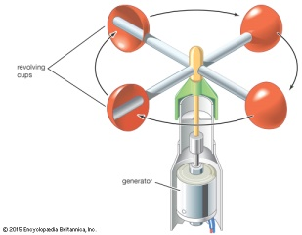
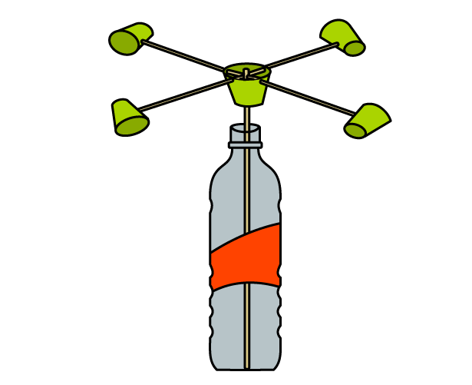
Anemometer
An anemometer is a device used for measuring wind speed, and is a common weather station instrument. The term is derived from the Greek word anemos, which means wind, and is used to describe any wind speed measurement instrument used in meteorology.

Slide 21
5 layers of atmosphere
Exosphere
Thermosphere
Mesosphere
Stratosphere
Troposphere

Slide 22
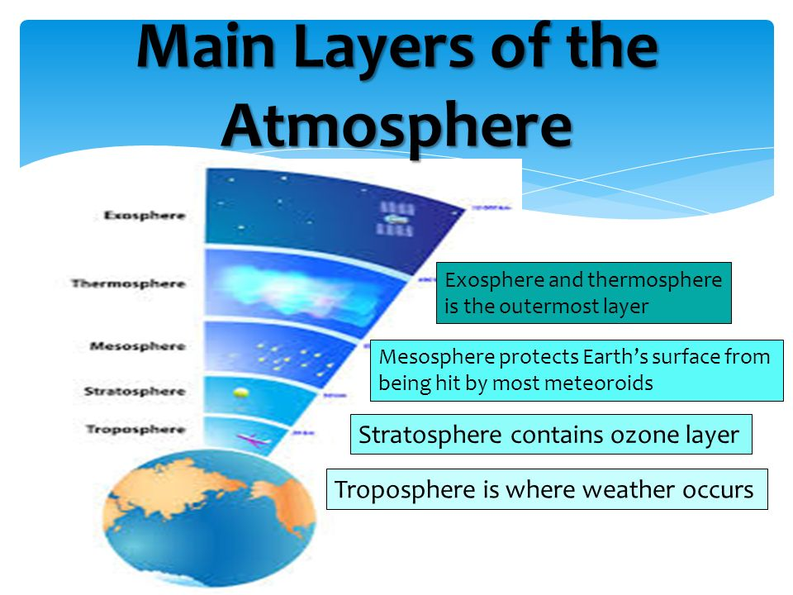

Slide 23
WEATHER SONG by Mr. Parr

