Slide 1

Pathfinder Bible Experience
2017
Paul’s Writings

Slide 2
Paul’s Writings
Galatians
Ephesians
Philippians
Colossians
1 & 2 Timothy
http://www.uccsda.org/Pathfinders/bibleachieve

Slide 3
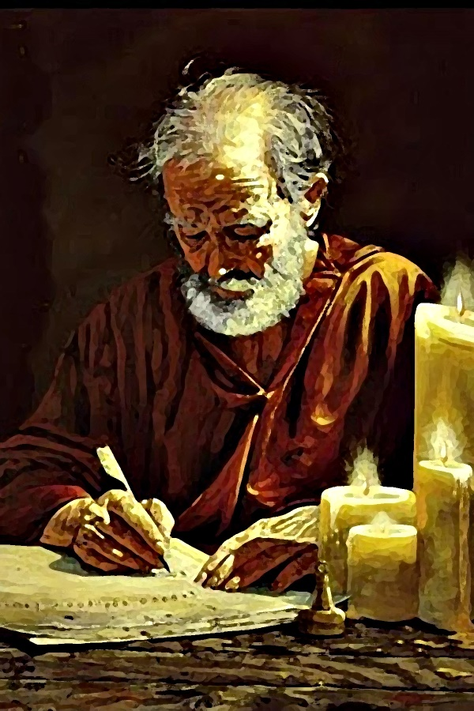
2 Timothy
Paul’s letter,

Slide 4

Chapter 1

Slide 5
According to 2 Timothy 1:1, Who was this letter written to?
2 points
25
Answer: Timothy

Slide 6
According to 2 Timothy 1:5, who in Timothy’s family first had faith or believed in Jesus?
2 points
25
Answer: his grandmother, Lois and his mother, Eunice

Slide 7
Complete 2 Timothy 1:7, “For God has not given us a spirit of fear, but of ______ and of _____ and of a sound _______.”
3 points
25
Answer: power, love, mind

Slide 8
1 point
25
According to 2 Timothy 1:8-12
What should we NOT be ashamed of?
the testimony of our Lord
suffering for the Lord
Paul, a prisoner
all the above

Slide 9
1 point
25
According to 2 Timothy 1:15-16, Who turned away from Paul?
Phygellus & Hermogenes
Onesiphorus
Timothy
all of the above

Slide 10
Chapter 2

Slide 11
According to 2 Timothy 2:2, Was Timothy supposed to be the only teacher? Who was he supposed to get to help him?
2 points
25
Answer: no, faithful men who were also able to teach others

Slide 12
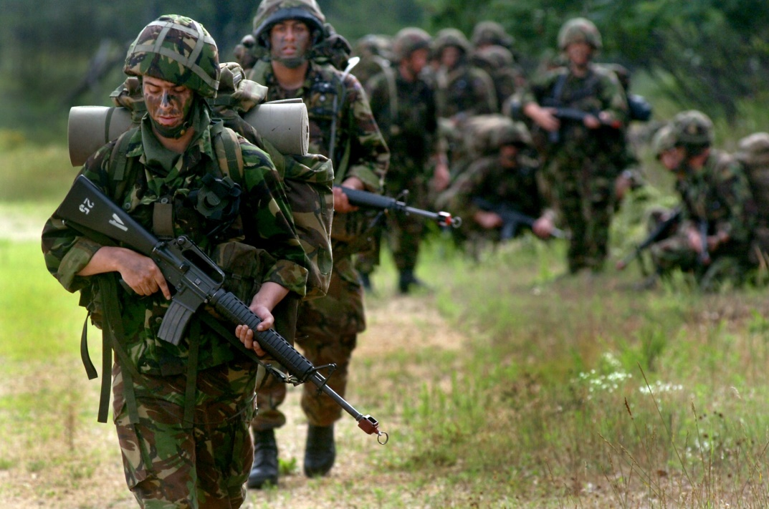
According to 2 Timothy 2:3-4, What can we learn from good soldiers?
2 points
25
Answer: 1) endure hardship
2)be focused and don’t get entangled with the affairs of this life

Slide 13
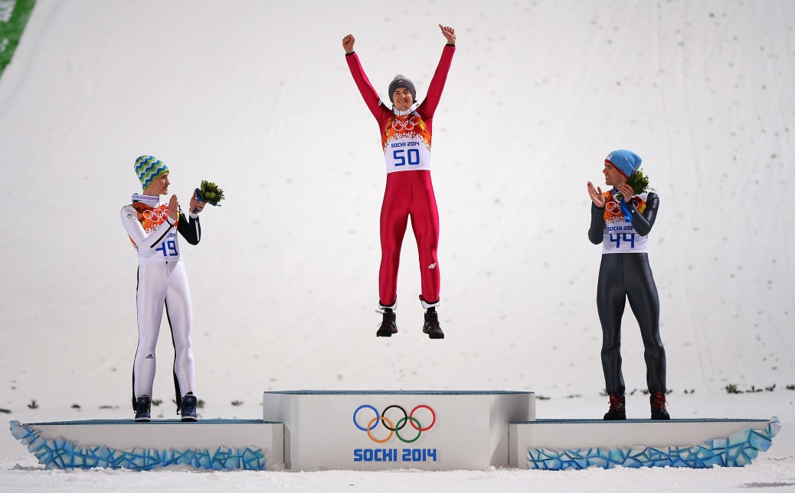
According to 2 Timothy 2:5, What can we learn from good athletes?
2 points
25
Answer: compete according to the rules (to win or get crown)

Slide 14
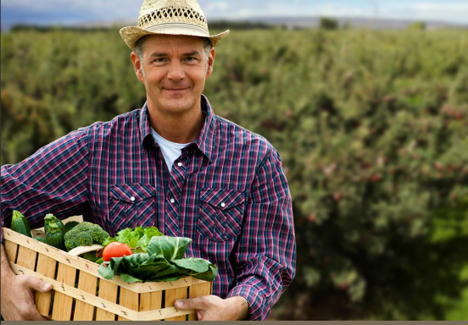
According to 2 Timothy 2:5, What can we learn from hardworking farmers?
2 points
25
Answer: they get to partake or eat from their crops first

Slide 15
Complete 2 Timothy 2:11-13, “This is a faithful saying: For if we died with Him, We shall also ___ with Him. If we endure, We shall also _____ with Him. If we deny Him, He also will deny ___. If we are faithless, He remains _________; He cannot deny Himself.”
4 points
25
Answer: live, reign, us, faithful

Slide 16
Complete 2 Timothy 2:15, “Be ________ to present yourself approved to God, a ______ who does not need to be ________, rightly dividing the word of truth. ”
3 points
25
Answer: diligent, worker, ashamed

Slide 17
Complete 2 Timothy 2:22, “Flee also youthful ______; but pursue _____________, faith, _____, peace with those who call on the Lord out of a pure heart.”
3 points
25
Answer: lusts, righteousness, love

Slide 18
Complete 2 Timothy 2:22, “But avoid ________ and ignorant disputes, knowing that they generate ________.”
2 points
25
Answer: foolish, strife

Slide 19
True or False According to 2 Timothy 2:24-26, A servant of the Lord should patiently correct those who are in opposition.
1 point
25
Answer: True

Slide 20
1 point
25
According to 2 Timothy 2:24-26
How should we NOT correct others?
patiently
gently
by quarreling
teach
humbly

Slide 21
According to 2 Timothy 2:25-26, Why should we correct others if they are in opposition?
3 points
25
Answer: So that they will
know the truth,
repent;
that they may come to their senses and escape the snare of the devil

Slide 22
Chapter 3

Slide 23
1 point
25
According to 2 Timothy 3:1-5,
What will many people NOT be like in the last days?
lovers of themselves, boasters, proud
lovers of money
blasphemers, unholy, slanderers, traitors
unthankful, unloving,
lovers of pleasure rather than God
disobedient to parents, despisers of good
have faith in Jesus & humbly obey God
without self control, brutal, headstrong, haughty

Slide 24

Do you think people are becoming more like this in the world?
lovers of themselves, boasters, proud
lovers of money
blasphemers, unholy, slanderers, traitors
unthankful, unloving,
lovers of pleasure rather than God
disobedient to parents, despisers of good
without self control, brutal, headstrong, haughty
OR this?
have faith in Jesus
humbly obey God
loving, kind, gentle, have self-control, patient

Slide 25
True or False According to 2 Timothy 3:5, When you meet such people you should agree with them, be friends and do what they do. Bonus: What should you do?
2 points
25
Answer: a) False b) from such people, turn away

Slide 26
Complete 2 Timothy 3:10, “But you have carefully followed my doctrine, manner of _____, purpose, _____, longsuffering, love, __________”
3 points
25
Answer: life, faith, perseverance

Slide 27
According to 2 Timothy 3:12, will the godly be persecuted?
2 points
25
Answer: yes

Slide 28
Complete 2 Timothy 3:14, “But you must ________ in the things which you have learned and been assured of, knowing from whom you have ________ them,”
2 points
25
Answer: continue, learned

Slide 29
Complete 2 Timothy 3:15, “… from childhood you have known the Holy __________, which are able to make you _____ for salvation through faith which is in ______ Jesus.”
2 points
25
Answer: Scriptures, wise, Christ

Slide 30
According to 2 Timothy 1:5, Who taught Timothy the scriptures when he was a child?
2 points
25
Answer: Grandmother Lois & Eunice, his mother

Slide 31
Complete 2 Timothy 3:16-17, “All _________ is given by inspiration of God, and is profitable for doctrine, for reproof, for ________, for instruction in righteousness, that the man of God may be complete, thoroughly ________ for every good work.”
3 points
25
Answer scripture, correction, equipped

Slide 32
Chapter 4

Slide 33
1 point
25
According to 2 Timothy 4:2,
Be ready in season and out of season to do what?
preach
convince
rebuke
exhort
all the above with longsuffering and teaching
only what their itching ears want to hear

Slide 34
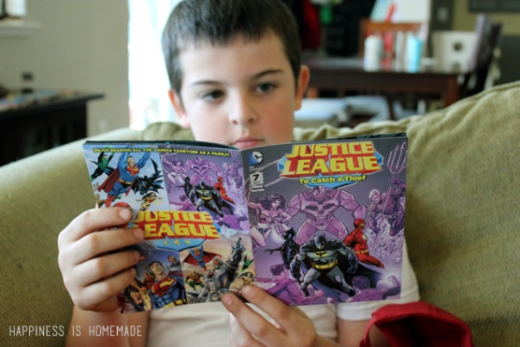
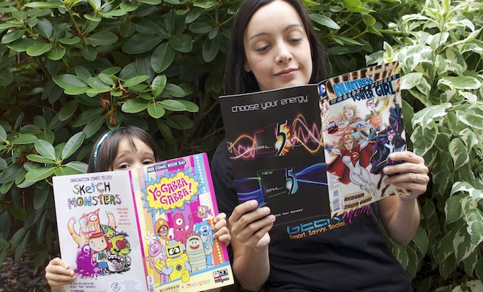
According to 2 Timothy 4:3-4, What did Paul warn people will do when they will not endure sound doctrine?
2 points
25
Answer: turn their ears away from truth
and turn aside to fables

Slide 35



Complete 2 Timothy 4:7, “I have fought the good ______, I have finished the _____, I have kept the ____”
3 points
25
Answer: fight, race, faith

Slide 36
Complete 2 Timothy 4:8, “Finally, there is laid up for me the crown of ______________, which the Lord, the righteous _______, will give to me on that Day, and not to me only but also to ___ who have loved His appearing.
3 points
25
Answer: righteousness, Judge, all

Slide 37
1 point
25
According to 2 Timothy 4:11-12,
Paul had some requests.
Who and what did Paul want?
Timothy to come
and bring Mark
the cloak Paul left in Troas
the books and parchments
all of the above

Slide 38
According to 2 Timothy 4:21, When was Paul hoping Timothy would come?
2 points
25
Answer: before winter

Slide 39
1 point
25
According to 2 Timothy 4:9-17
Who stood with Paul and strengthened him?
Demas
Crescens
Alexander
the Lord
all of the above

Slide 40
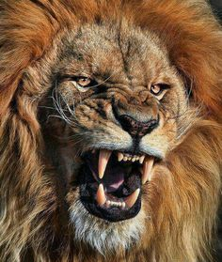
True or False According to 2 Timothy 4:17, Paul was delivered out of the mouth of a lion.
2 points
25
Answer: True

Slide 41
Complete the promise, 2 Timothy 4:18, “And the Lord will _______ me from every evil work and ________ me for His heavenly kingdom. To Him be glory ______ and ever. Amen!”
3 points
25
Answer: deliver, preserve, forever

Slide 42
1 point
25
According to 2 Timothy 4:19
Who, in the household of Onesiphorus, should Timothy greet?
Prisca & Aquila
Twosiphorus & Threesiphorus
Bob & Larry
Mickey & Minnie

Slide 43
1 point
25
According to 2 Timothy 4:21,
Who sent their greetings to Timothy?
Eubulus
Pudens
Linus
Claudia
all of the above
none of the above

Slide 44
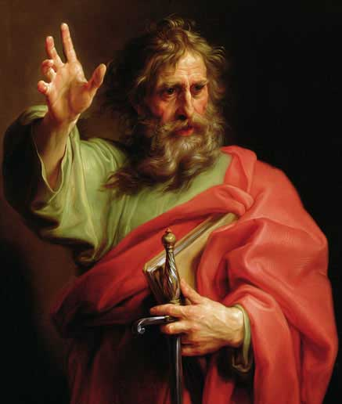
Farewell The Lord Jesus Christ be with your spirit. Grace be with you. Amen.

