Slide 1



Slide 2
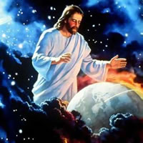

“Worship Him who made the heaven, and the earth, and sea and fountains of waters.” Revelation 14:7

Slide 3

I’m Part of God’s Creation

Slide 4

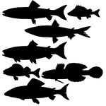
God Created
by Christy Semsen
8 volunteers are needed to choose the birds and fish in the song.
Come stand up front and be ready to say your fish or bird.

Slide 5


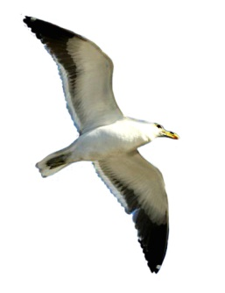

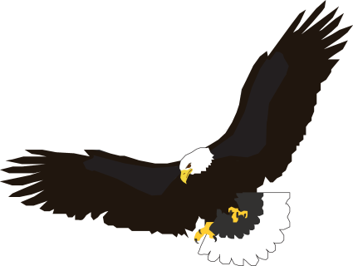
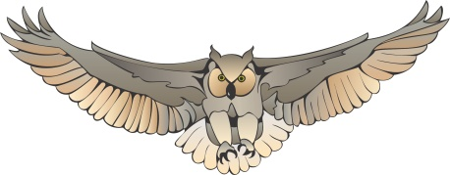


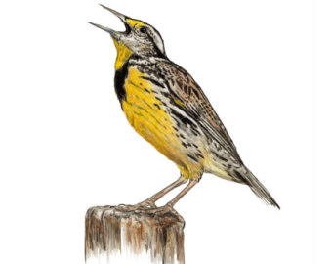
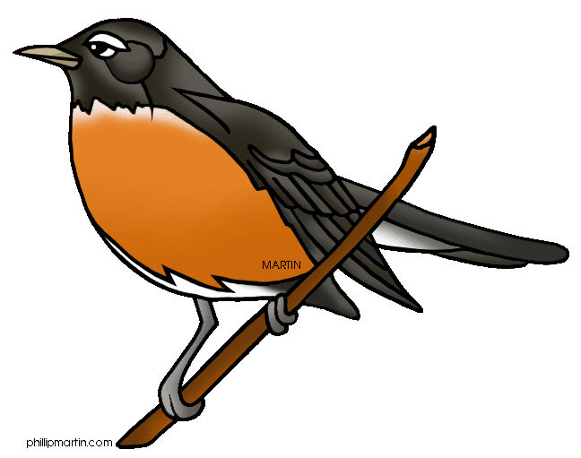
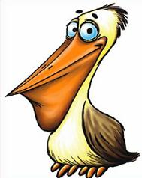
God created _______
God created ________
I will lift my voice and sing hallelujah!
sparrow
owl
seagull
raven
robin
lark
heron
pelican
dove
eagle

Slide 6

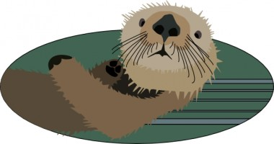
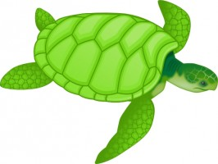
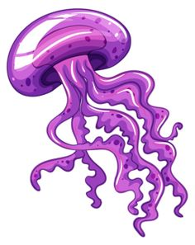



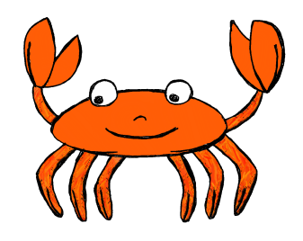
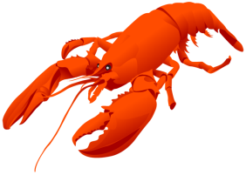
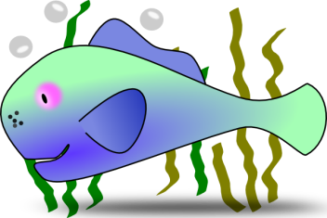

God created _______
God created _______
Let’s all shout and praise and sing hallelujah

Slide 7
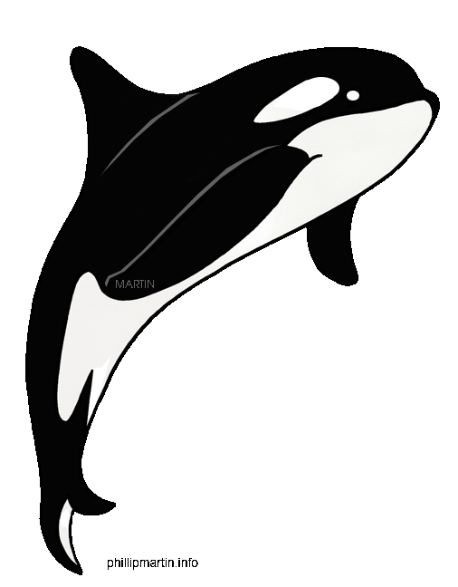
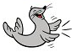
I will use my hands
And I will use my voice
I dedicate my gifts
To praise the King on high

Slide 8
God created _______
God created ________
I will lift my voice and sing hallelujah!
sparrow
owl
seagull
raven
robin
lark
heron
pelican
dove
eagle

Slide 9
Our God is full of strong, gentle love
Always there

Slide 10
Our God can care for us today
and always
Our God will never, never, leave
ever hurt us,
Our God is love Oh so loving
Always there

Slide 11
God created _______
God created _______
Let’s all shout and praise and sing hallelujah

Slide 12
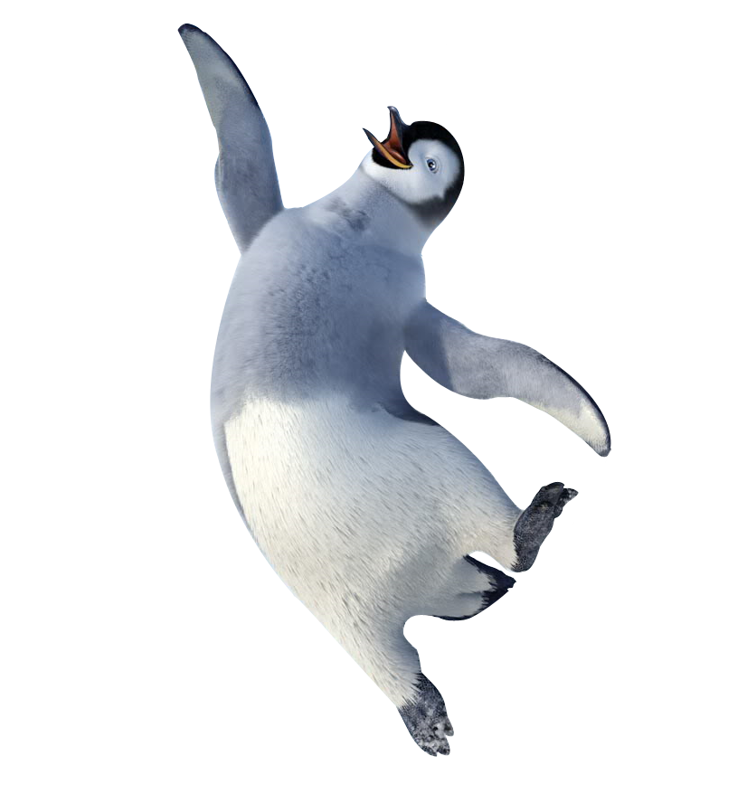
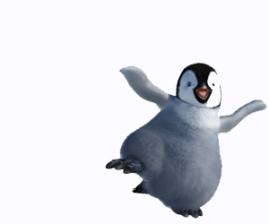
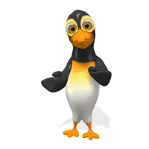
Let’s all shout and praise and sing hallelujah

Slide 13
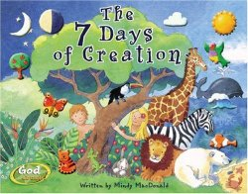

It’s Bible Story Time

Slide 14

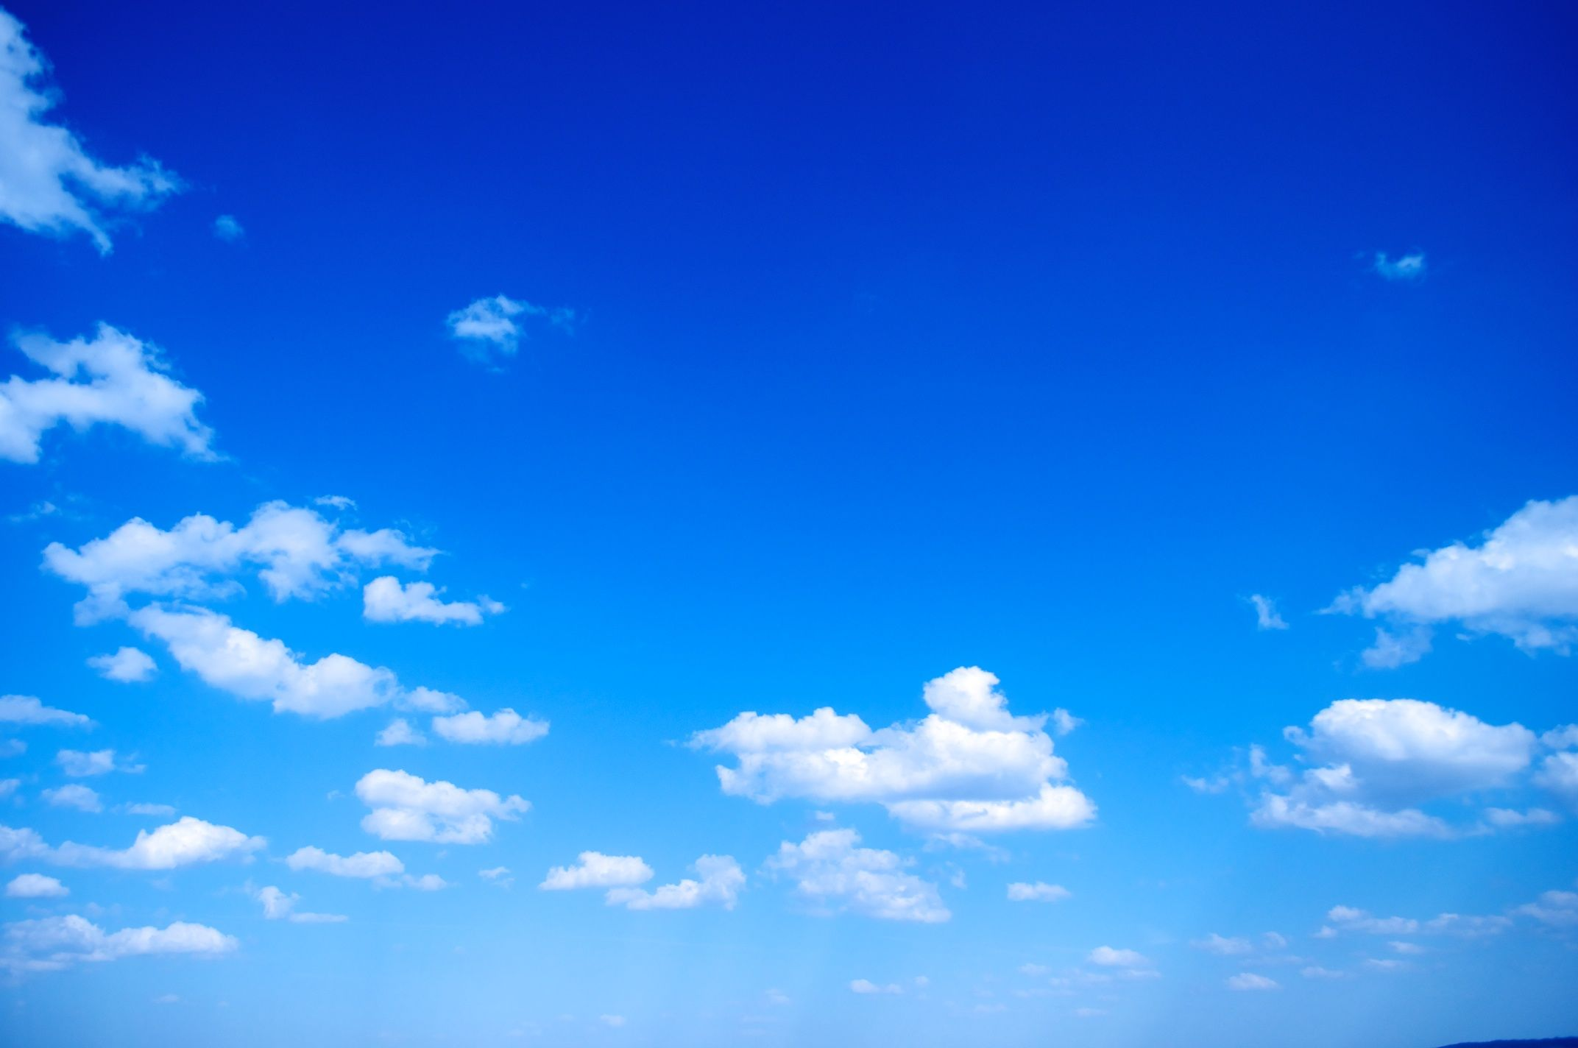
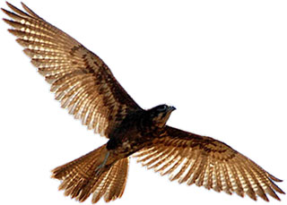
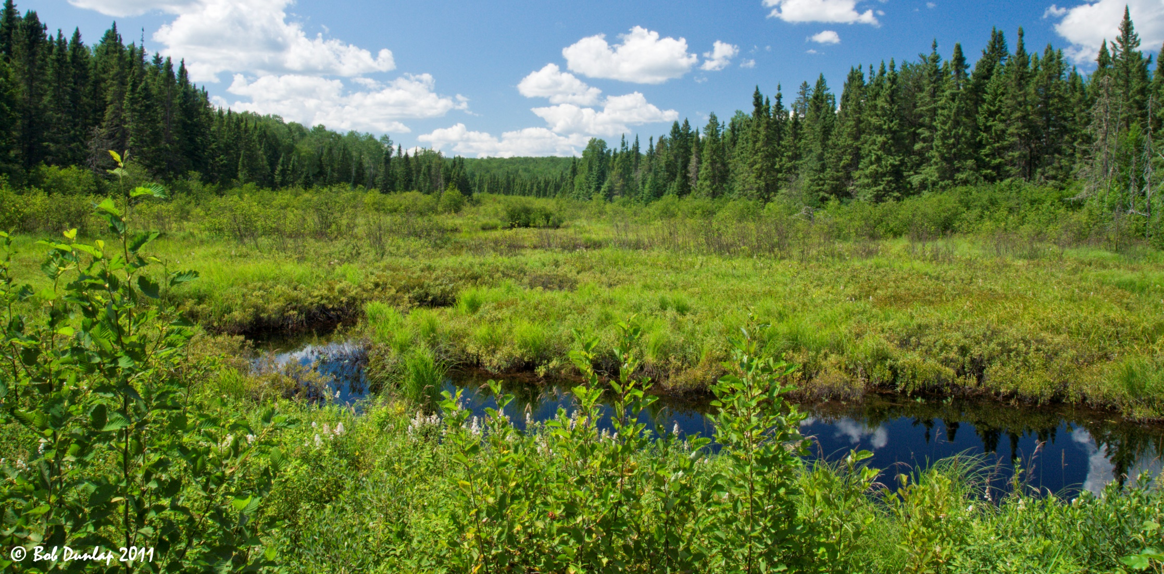

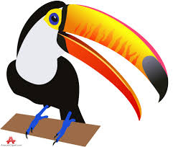
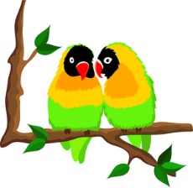
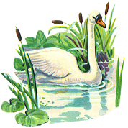
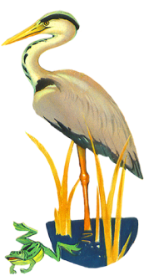
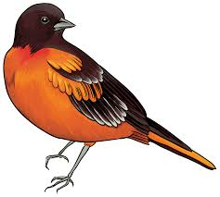
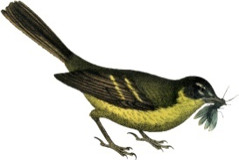
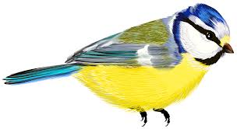
God said, “Let the land produce every kind of living creature. Let there be livestock, and creatures that move along the ground, and wild animals.”
Genesis 1:24

Slide 15
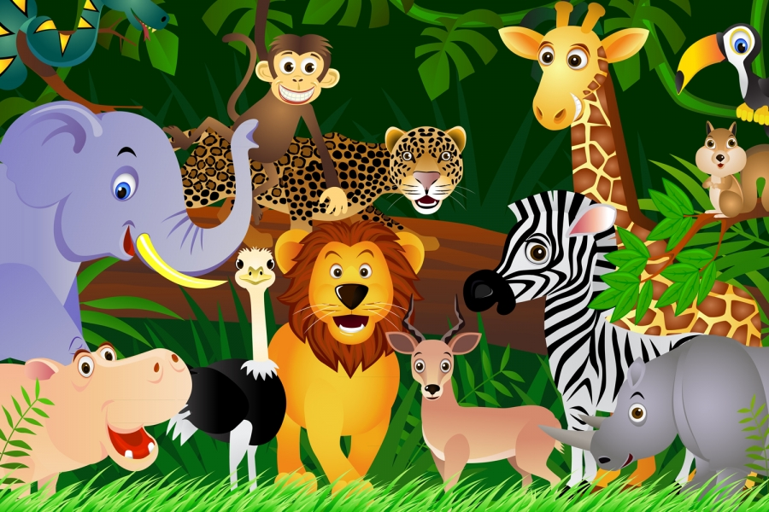
“And that’s exactly what happened. God made every kind of wild animal.” Genesis 1:24-25

Slide 16
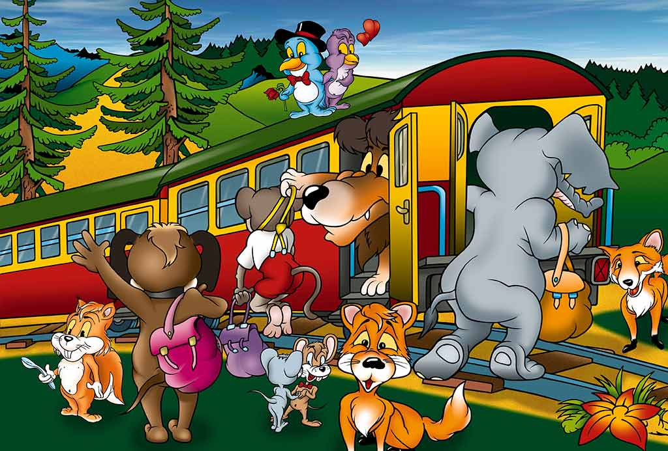
King’s Animal Kingdom

Slide 17
Welcome to the King’s animal kingdom
Hop on board to see what God has made!

Slide 18
Welcome to the King’s animal kingdom
Hop on board to teach us of His ways!

Slide 19
Welcome to the King’s animal kingdom
Hop on board to see what God has made!

Slide 20
Welcome to the King’s animal kingdom
Oh, hop on board to teach us of His ways!

Slide 21
We’ll pant for water like the deer and soar
like eagles in the sky
Cause you are stronger than the lions
for we worship
you on high

Slide 22
For if you care
for all the sparrows and I know you’ll care for me

Slide 23
And I’ll join with all creation and sing praises to the King!
Praises to the King!

Slide 24
Welcome to the King’s animal kingdom
Hop on board to see what God has made!

Slide 25
Welcome to the King’s animal kingdom
Hop on board to teach us of His ways!

Slide 26
What an animal to animal adventure!
What an absolute fabulous day!

Slide 27
What an animal to animal adventure
Time to hurry down to start on our way

Slide 28
Welcome to the King’s animal kingdom
Hop on board to see what God has made!

Slide 29
Welcome to the King’s animal kingdom
Oh, Hop on board to teach us of His ways!

Slide 30
Hop on board to see what God has made!
Hop on board to teach us of His ways!

Slide 32

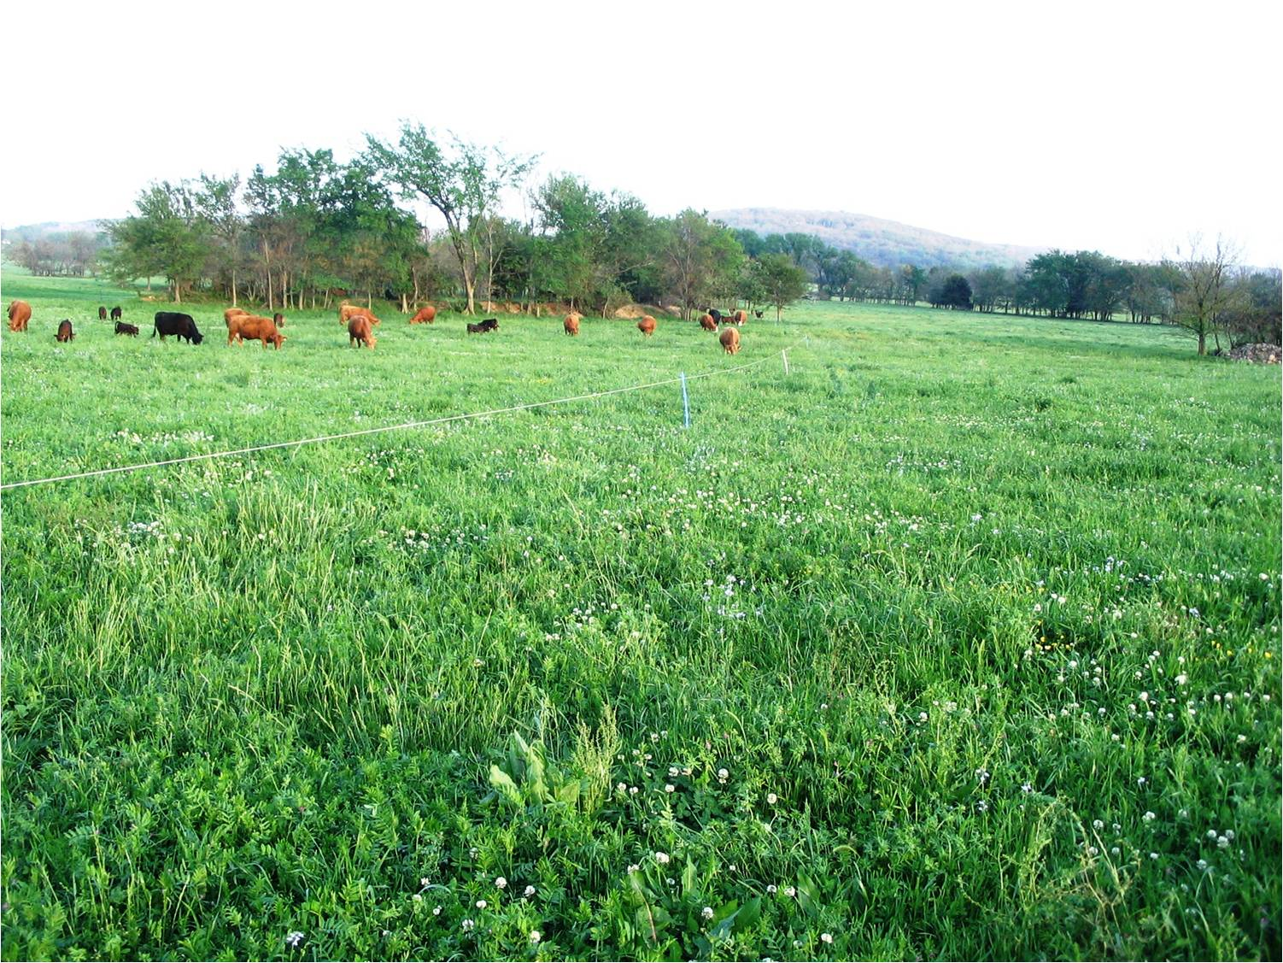
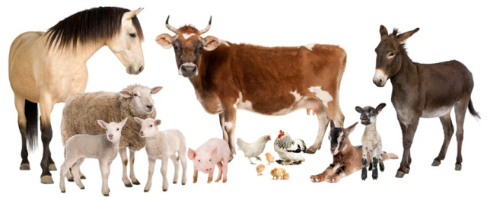
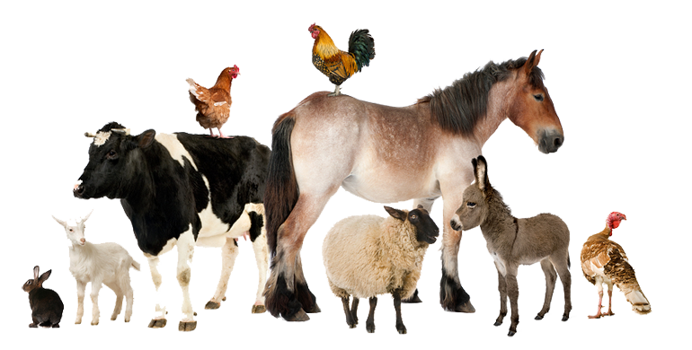
He made every kind of livestock.

Slide 33
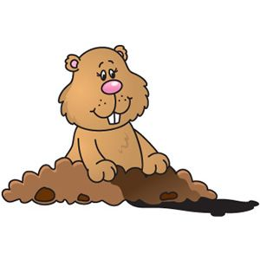
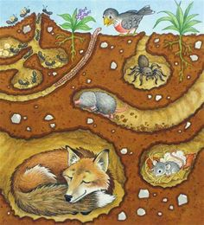
“He made every kind of creature that moves along the ground. And God saw that it was good.”
But He wasn’t done yet.

Slide 34
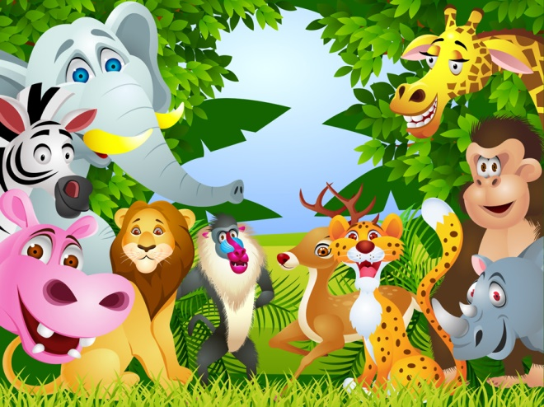
Lord of Creation

Slide 35
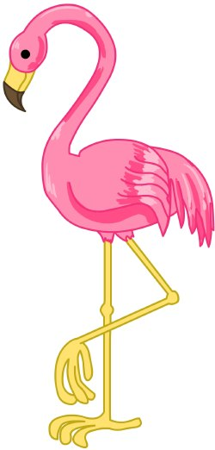

Who gave the panda
his adorable face
Who gave flamingos
their ballerina grace

Slide 36

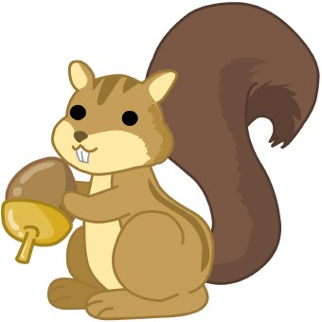
Who gave the penguins
a tuxedo, too
Who taught the squirrels to
gather acorns a few

Slide 37
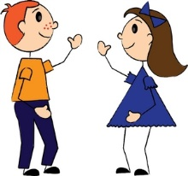

I know who!
The question is do you?
Do you?
Tell me, tell me, do you?

Slide 38
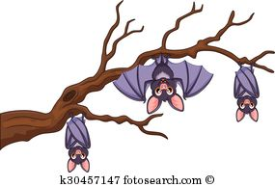
Who taught the eagles
to soar in the clouds?
Who taught the scary bats
to hang upside down?

Slide 39
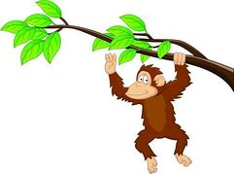
Who taught the chimpanzee
to swing from the tree?
Who taught the school of fish
to swim in the sea?

Slide 40
I know who!
The question is do you?
Do you?
Tell me, tell me, do you?

Slide 41
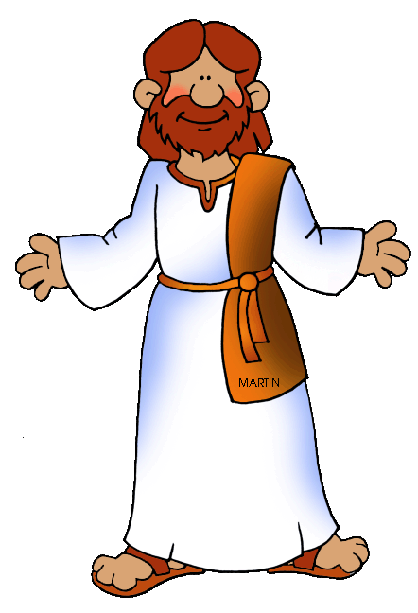
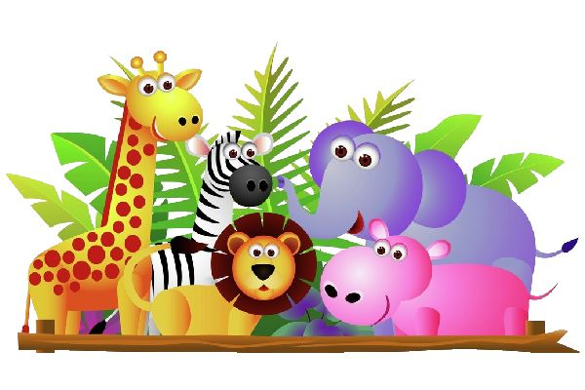
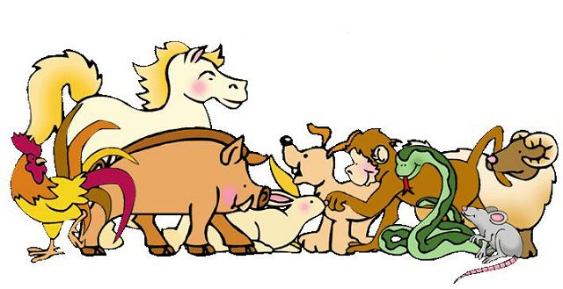
Oh, the Lord of creation,
yes, the Lord made it all!
The Lord of creation,

Slide 42

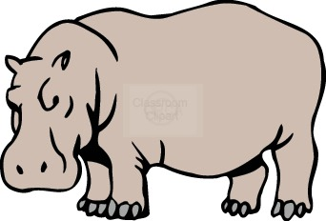
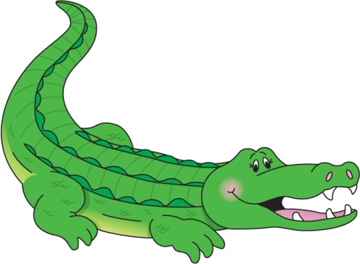

He made all things
great and small.
Everything that moves
and breaths,
everything from sky to sea

Slide 43
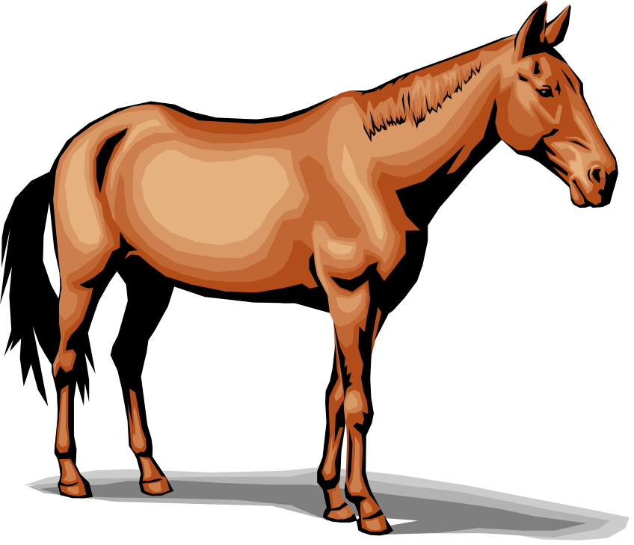
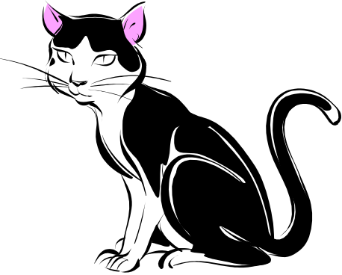

The Lord of creation
made them all
for you and me
So tell me can you see?

Slide 44



Who knew all about me,
before I was born?
Who knew the very day
my life was transformed.

Slide 45

He opened my eyes
and now He lives
in my heart
I am a new creation
and forever will be a part

Slide 46
I know who!
The question is do you?
Do you?
Tell me, tell me, do you?

Slide 47
Oh, the Lord of creation,
yes, the Lord made it all!
The Lord of creation,

Slide 48
He made all things
great and small.
Everything that moves
and breaths,
everything from sky to sea

Slide 49
The Lord of creation
made them all
for you and me

Slide 50
I know who!
The question is do you?
Do you?
Tell me, tell me, do you?
Tell me, tell me, do you?
Tell me, tell me, do you?

Slide 51

Just like Adam and Eve,
We were created by God

Slide 52

Then God said, “Let us make human beings so that they are like us. Let them rule over the fish in the seas and the birds in the sky. Let them rule over the livestock and all the wild animals. And let them rule over all the creatures that move along the ground.”

Slide 53
Then the Lord God formed a man from the dust of the ground and breathed into his nostrils the breath of life, and the man became a living being…
The Lord God took the man and put him in the Garden of Eden to work it and take care of it…
The Lord God said, “It is not good for the man to be alone. I will make a helper suitable for him.”
“So the Lord God caused the man to fall into a deep sleep; and while he was sleeping, he took one of the man’s ribs and then closed up the place with flesh. Then the Lord God made a woman from the rib he had taken out of the man, and he brought her to the man.”
Genesis 2:7, 18, 20-22

Slide 54



Woven Together
Christy Semsen Creation Sensation

Slide 55

Like a piece of cloth
in a tailor’s hand
I was woven together
with a pattern and a plan
Every mix of such color,
every tiny thread
Evidence of the handiwork of the Great I AM

Slide 56








Woven together,
wonderfully made
Woven together
by the Father’s hand
You love me!
You knew me before I was born
Yeah!

Slide 57



Your works are wonderful,
this I know!
I’m your creation,
the Bible tells me so.

Slide 58







Every gift and talent,
Every hidden flaw
Still evidence of the handiwork of the Great I AM

Slide 59
Woven together,
wonderfully made
Woven together
by the Father’s hand
You love me!
You knew me before I was born
Yeah!

Slide 60

You love me!
You knew me before I was born
Yeah!

Slide 61


Search me Oh God
and know my heart
Test me and know
my anxious thoughts
Sometimes I forget in the dark
that you created me
I’m set apart!

Slide 62
Woven together,
wonderfully made
Woven together
by the Father’s hand
You love me!
You knew me before I was born
Yeah!

Slide 63
You love me!
You knew me before I was born
Yeah!

Slide 64
Like a piece of cloth
in a tailor’s hand
I was woven together
with a pattern and a plan

Slide 65

“Now the Lord God… brought (the wild animals and birds) to the man to see what he would name them; and whatever the man called each living creature, that was its name.”
Genesis 2:19

Slide 66

So God created human beings in his own likeness.
He created them to be like himself.
He created them as male and female.
God blessed them. He said to them, “Have children so that there will be many of you. Fill the earth and bring it under your control. Rule over the fish in the seas and the birds in the sky. Rule over every living creature that moves along the ground.”
Genesis 1:27-28

Slide 67
…
God saw everything he had made. And it was very good. There was evening, and there was morning. It was day six..”
Genesis 1:29-31

Slide 68
A verse to remember
“I praise you
because I am fearfully and wonderfully made.”
Psalms 139:14

Slide 69

I Am Fearfully and Wonderfully Made
By Jim Bailey
https://vimeo.com/78853652

Slide 70

I Am Fearfully and Wonderfully Made
By Jim Bailey

Slide 71
I am fearfully & wonderfully made
I am fearfully & wonderfully made

Slide 72


He who put the stars in place,
and knows them all by name
has made me
Fearfully & wonderfully made

Slide 73

I am made in the image of God
I am made in the image of God

Slide 74


From the top of my head
to the tip of my toes
My Lord my name He knows
I am made in the image of God

Slide 75




Slide 76
I am fearfully & wonderfully made
I am fearfully & wonderfully made

Slide 77
He who put the stars in place,
and knows them all by name
has made me
Fearfully & wonderfully made

Slide 78
I am made in the image of God
I am made in the image of God

Slide 79
From the top of my head
to the tip of my toes
My Lord my name He knows
I am made in the image of God

Slide 80
He who put the stars in place,
and knows them all by name
has made me
Fearfully & wonderfully made
The end

Slide 81





Creation Discovery
Science Time

Slide 82


Child of God
Christy & Daniel Semsen Creation Sensation

Slide 83





Magazines, skinny jeans,
keeping with the latest trends
Fashion, hairstyles,
obsession never ends

Slide 84

But God looks at the heart
Not the things other people see
People see the outside
But there so much more to me

Slide 85
I’m a child of God
And that’s what really matters
I’m a child of God
No matter what they say

Slide 86

I may not look like you
God made us different
I’m a child of God
And that’s what really matters

Slide 87


Let’s train our eyes to see
what is truly real
Stop pretending,
hoping to hide
the way we feel

Slide 88
For God looks at the heart
Not the things other people see
People see the outside
But there so much more to me

Slide 89
I’m a child of God
And that’s what really matters
I’m a child of God
No matter what they say

Slide 90
I may not look like you
God made us different
I’m a child of God
And that’s what really matters

Slide 91

A child of God
I’m a child of God
A child of God

Slide 92

If I Were a Butterfly

Slide 93








I Am a Promise
hand motions: https://www.youtube.com/watch?v=z0Zx5M1_j2E

Slide 94







The Creation Song -- 2nd version

Slide 95
“Worship Him who made the heaven, and the earth, and sea and fountains of waters.” Revelation 14:7

Slide 96


Interactive Bible Story
We have some animals that you can bring up to our scene. I will dismiss you by age so that you can choose 1 and bring it to your seat.
Then when I say, “Let the land produce every kind of living creature. Let there be livestock, and creatures that move along the ground, and wild animals.” you may bring them up to our creation scene.

Slide 97

Great big beautiful world
All the Best Songs for Kids #181

Slide 98
Great Big Beautiful World
God made a great big beautiful world
With all the right ingredients in it
A great big beautiful wonderful world
And what a way to begin it

Slide 99





With moving creatures on land and sea
And even a twosome like you and me;

Slide 100

What a great big wonderful, glorious, marvelous, great big beautiful world!

Slide 101

Our heavenly Father did it right;
He started at the very beginning.
He hung the planets, moon and stars.
And set it all to spinning.

Slide 102



He separated dark from light, made the sun for day and the moon for night
When that was done, He looked around and said, “That’s all right.”

Slide 103
God made a great big beautiful world
With all the right ingredients in it
A great big beautiful wonderful world
And what a way to begin it

Slide 104
With moving creatures on land and sea
And even a twosome like you and me;

Slide 105




What a great big wonderful, glorious, marvelous, great big beautiful world!
What a great big wonderful, glorious, marvelous, great big beautiful world!

Slide 106











It’s time to go to our activities!

