Slide 1
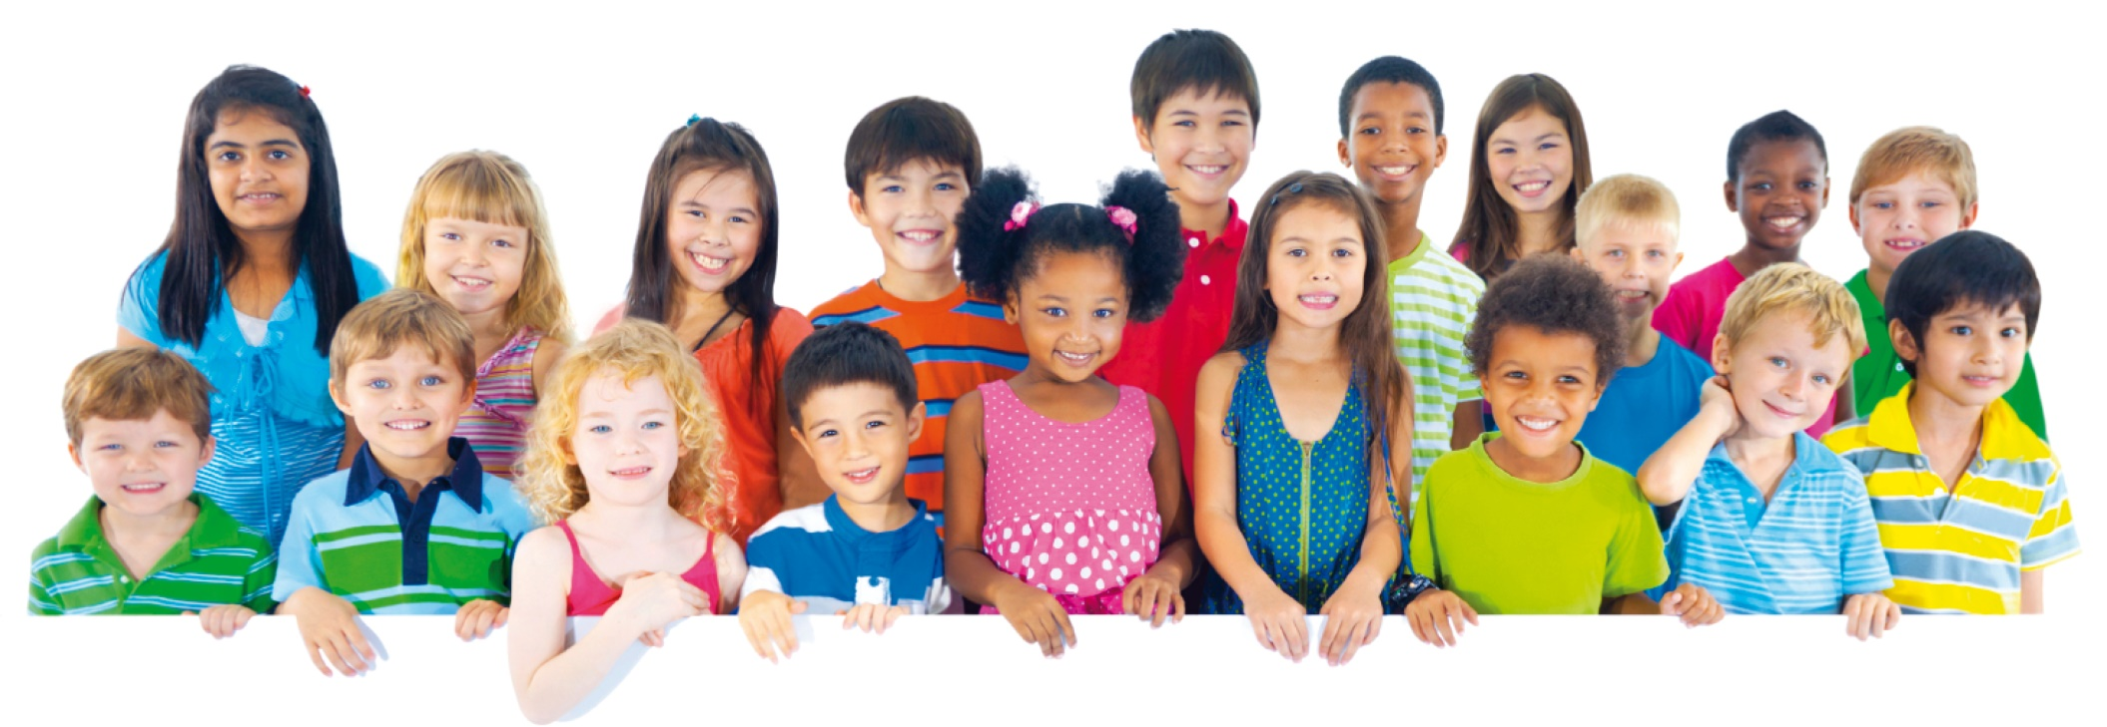
God loves you very much!
You are God’s awesome creation

Slide 2

God, Thank you for making me!
Psalms 139:13
“You created the deepest parts of my being.
You put me together inside my mother’s body.”
Psalms 139:15
“None of my bones was hidden from you when you made me inside my mother’s body.
That place was as dark as the deepest parts of the earth..”
Psalms 139:14
“How you made me is amazing and wonderful.
I praise you for that.
What you have done is wonderful.
I know that very well..”
Psalms 139:15, 16
“When you were putting me together there, your eyes saw my body even before it was formed.
You planned how many days I would live..”

Slide 3
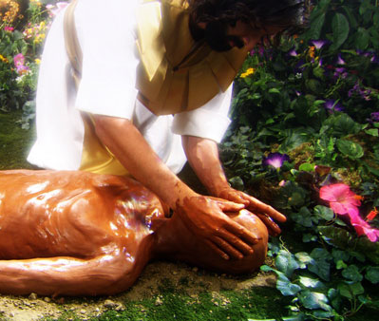
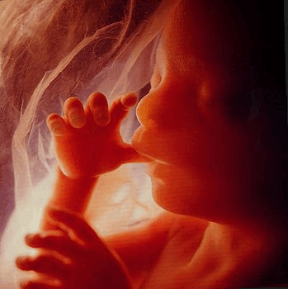
We are created by God

Slide 4
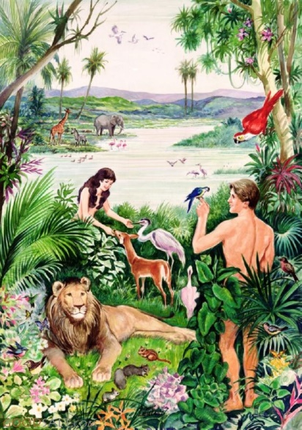
Adam’s job
Genesis 2:15
The Lord God put the man in the Garden of Eden. He put him there to farm its land and take care of it.
Genesis 2:19
The Lord God had formed all the wild animals and all the birds in the sky. He had made all of them out of the ground. He brought them to the man to see what names he would give them. And the name the man gave each living creature became its name.

Slide 5
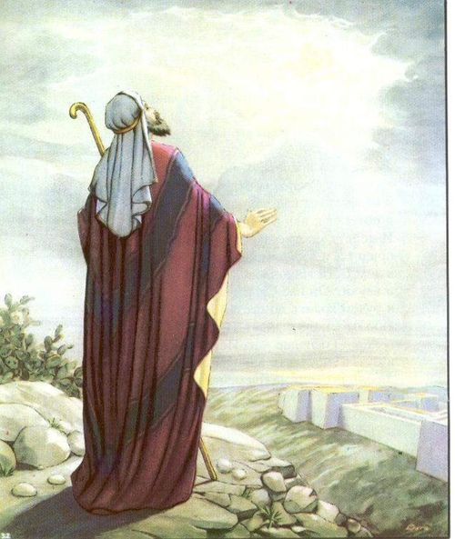
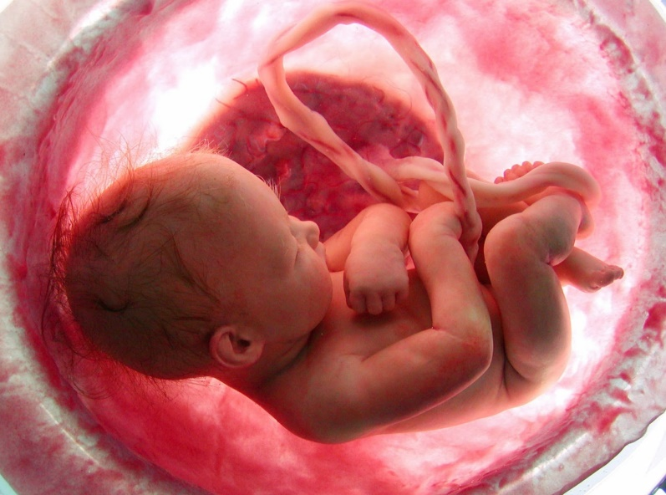
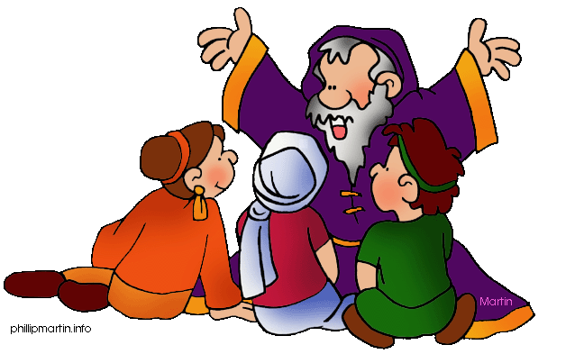
Isaiah and Jeremiah -- prophets
Isaiah 49:5
The Lord is the one who made me in my mother’s womb,
so that I could be his servant.
He wanted me to lead Jacob and Israel back to him.
The Lord gives me honor.
I get my strength from my God.
Jeremiah 1:5
“Before I made you in your mother’s womb,
I knew you.
Before you were born,
I chose you for a special work.
I chose you to be a prophet to the nations.”

Slide 6
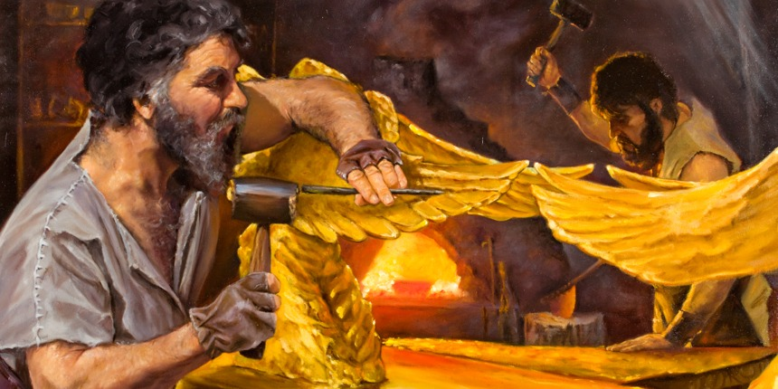
Bezalel and Oholiab
Exodus 31:1-6
Then the Lord said to Moses, “I have chosen a man from the tribe of Judah to do some special work for me. His name is Bezalel son of Uri son of Hur.
I have filled Bezalel with the Spirit of God—I have given him the skill and knowledge to do all kinds of things. He is a very good designer. And he can make things from gold, silver, and bronze. He can cut and set beautiful jewels. And he can work with wood. He can do all kinds of work.
I have also chosen Oholiab to work with him. Oholiab is the son of Ahisamach from the tribe of Dan. And I have given skills to all the other workers so that they can make everything that I have commanded you:

Slide 7
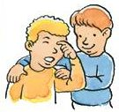
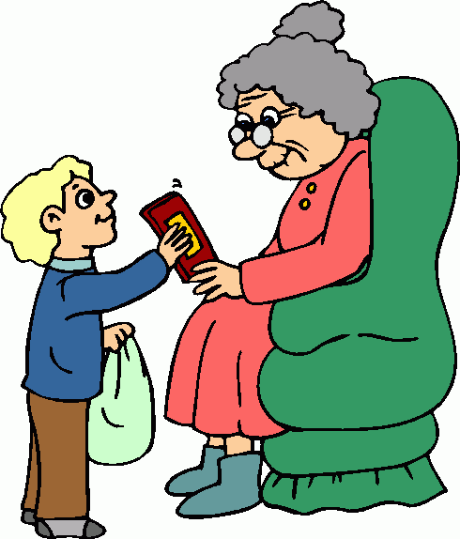

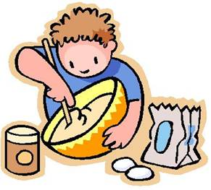
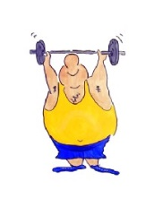














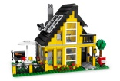

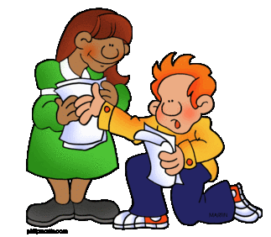


What are your talents?
Social Talent
Social Talent
Home Talents
Physical Talent
Social Talent
sensitive to others
Nature Talent
good friend
cooking
strength
leadership
plant care
Intellectual Talent
Technology Talent
Home Talents
Nature Talent
understand things well
Intellectual Talent
operates machines
Artistic Talent
cleaning
science
decision making
coloring
Language Talent
Building Talent
Home Talents
Musical Talent
writing
Language Talent
Talent in Math
putting things together
first aid
sing
drama
+ - / x numbers

