Slide 1
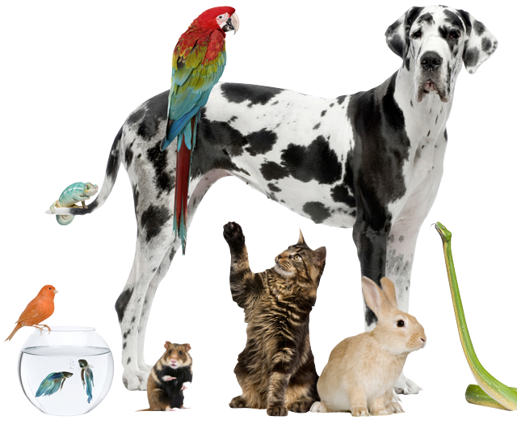
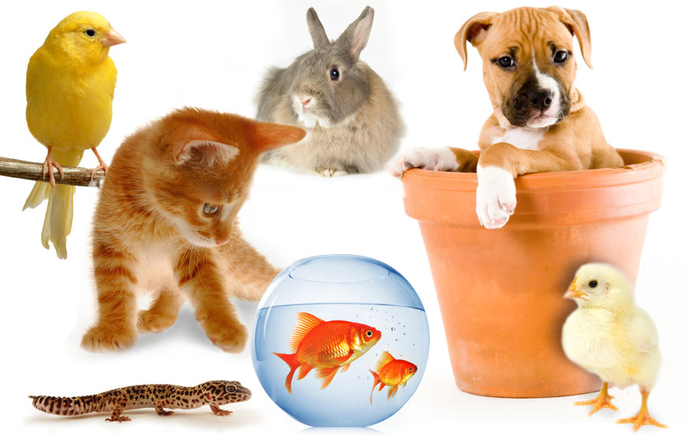

Slide 2
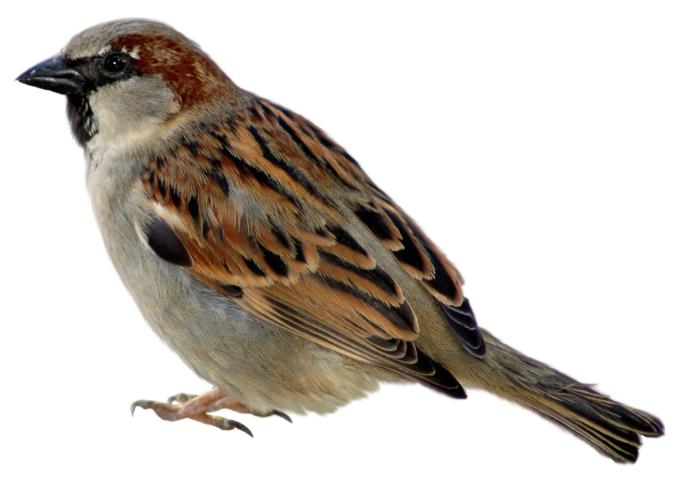
Matthew 10:29
Are not two sparrows sold for a penny? Yet not one of them will fall to the ground outside your Father’s care.

Slide 3
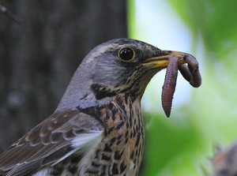
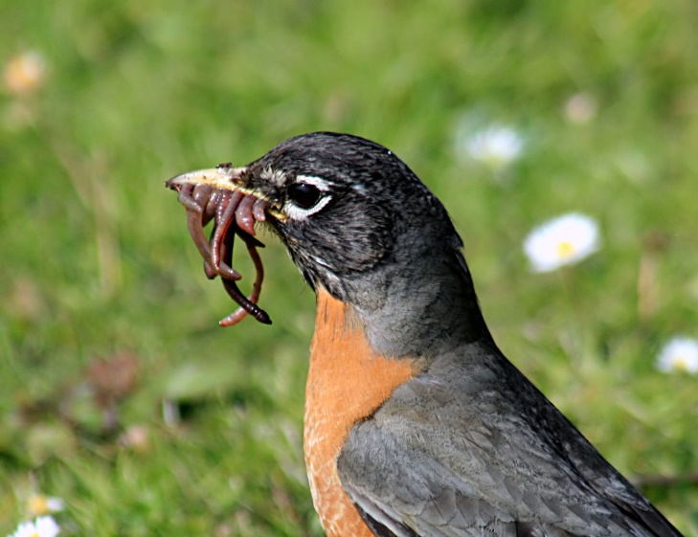
Matthew 6:26
Look at the birds of the air. They don’t plant or gather crops. They don’t put away crops in storerooms. But your Father who is in heaven feeds them. Aren’t you worth much more than they are?

Slide 4
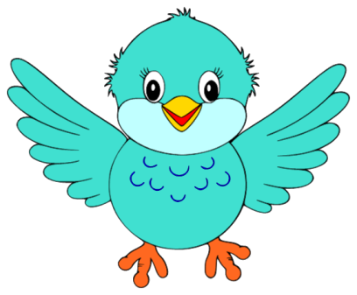
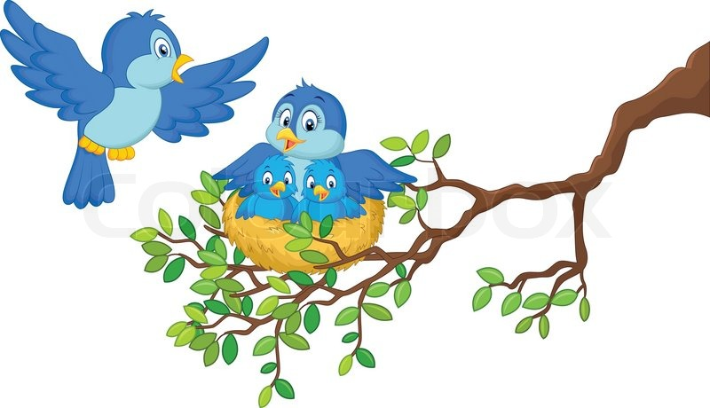

Just like sparrows,
We can trust God’s care
The sparrows do not worry about what they will eat or where they will rest.
Their heavenly Father, our Creator God cares for them.
We are worth much more than a sparrow.
Our heavenly Father, our Creator God cares for us, too.
We do not need to worry or fret.

Slide 5
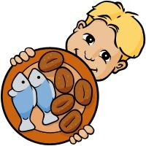

5 Loaves and 2 Fishes

Slide 6
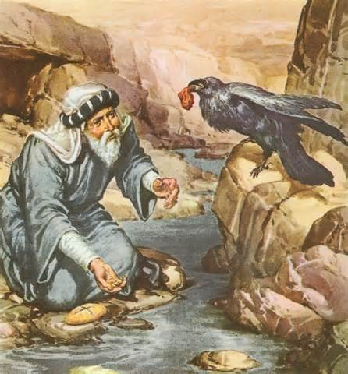
Elijah and the Ravens

Slide 7
