Slide 1



Slide 2

When do you like light?
What kind of lights
do you like?

Slide 3
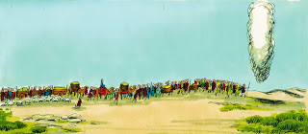

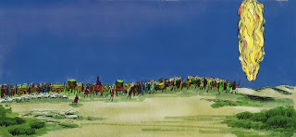
“By day the Lord went ahead of them in a pillar of cloud to guide them on their way and by night in a pillar of fire to give them light, so that they could travel by day or night.”
Exodus 13:21

Slide 4
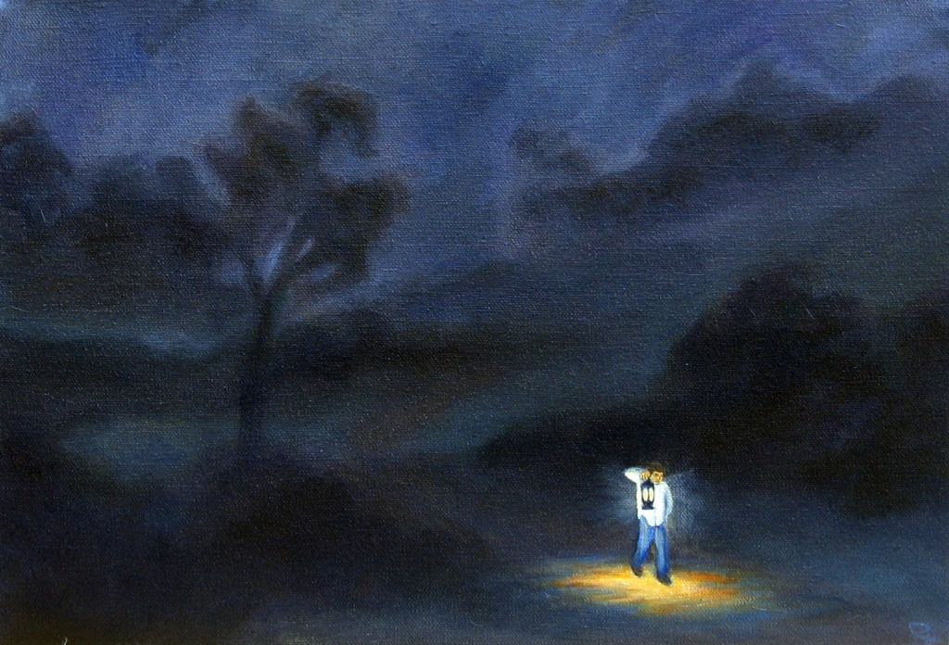
“Your word is a lamp for my feet,
a light on my path.”
Psalms 119:105

Slide 5



God directions to make every day fun, fair, and happy for everyone
go to 21:56 play until 25:03

Slide 6

Just like light,
Jesus shows the way
A light shows the path and dangers
Jesus shows us the path and the way we should live.
God’s book, the Bible, tells us more. It points out the dangers and God’s way to eternal life.

Slide 7
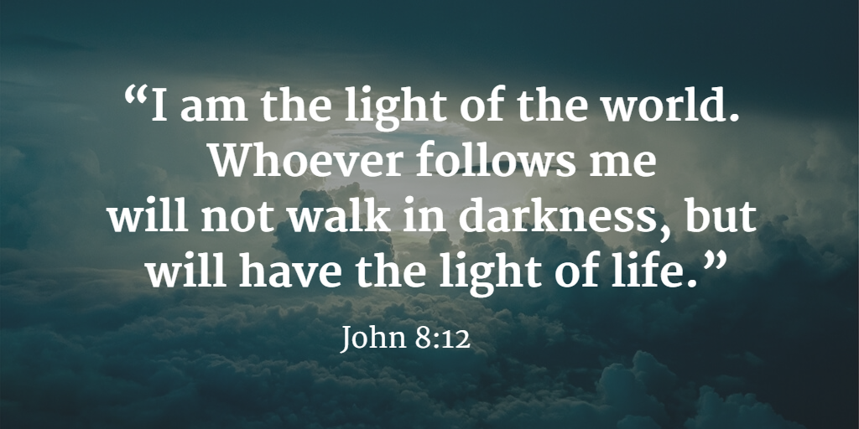


Slide 8
“Love the Lord your God with all your heart and with all your soul and with all your mind.” Matthew 22:37
“Love your neighbor as yourself.” Matthew 22:39
Exodus 20:3-17
“You shall have no other gods before me.
“You shall not make for yourself an image in the form of anything in heaven above or on the earth beneath or in the waters below. You shall not bow down to them or worship them; …
“You shall not misuse the name of the Lord your God, …
“Remember the Sabbath day by keeping it holy. Six days you shall labor and do all your work, but the seventh day is a Sabbath to the Lord your God. On it you shall not do any work, ….
“Honor your father and your mother, so that you may live long in the land the Lord your God is giving you.
“You shall not murder.
“You shall not commit adultery.
“You shall not steal.
“You shall not give false testimony against your neighbor.
“You shall not covet your neighbor’s house. … or anything that belongs to your neighbor.”

Slide 9





